Slide 1
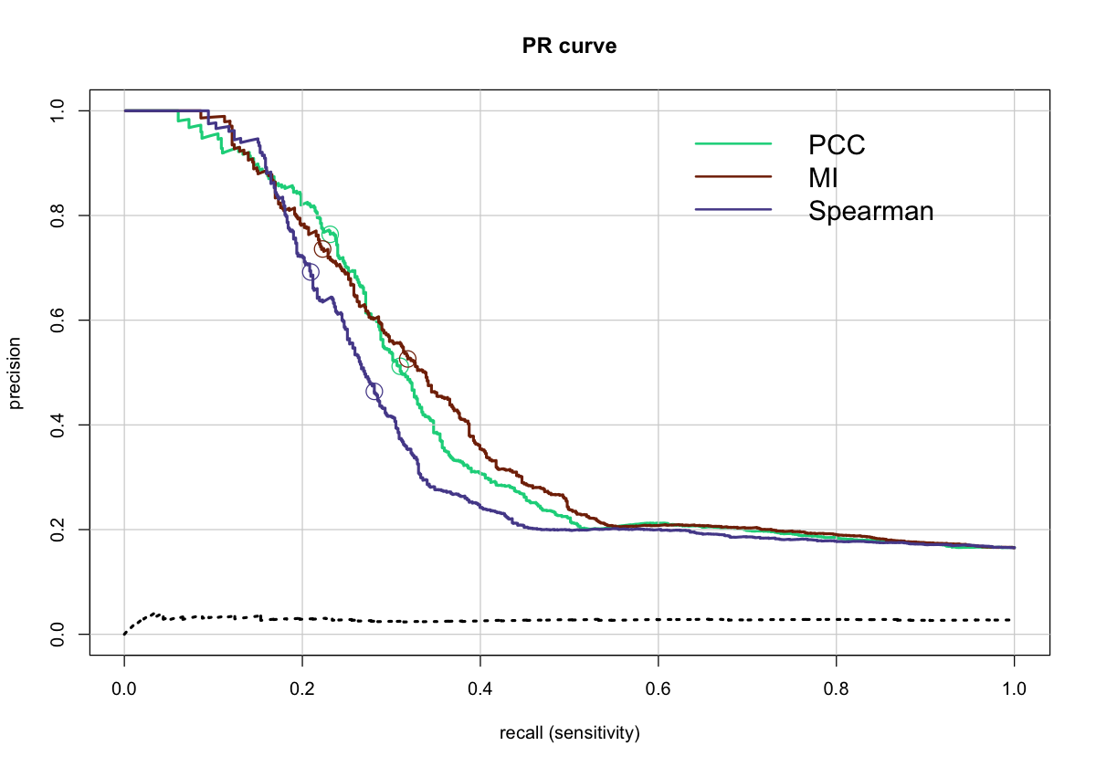
250th
500th
precision
recall (sensitivity)
FIGURE S7. Precision-recall curves when phenotypic profile similarity is determined using different metrics. Gene pairs were ranked from high to low similarity based on |PCC| (green line), MI (brown line), or |SRCC| (blue line). Precision and recall were then calculated for the 5,000 top-ranked gene pairs using the union of annotation sets 1 through 5 to identify co-annotated gene pairs. Circles indicate the positions of the 250th and 500th top-ranked gene pairs. The dashed line shows precision for randomly ordered gene pairs generated as described in the Methods (negative control). The areas under the curve (AUC) when pairwise profile similarity is determined using |PCC|, MI, |SRCC| or for randomly ordered gene pairs are: 0.42, 0.43, 0.39, and 0.17, respectively.

