Slide 1
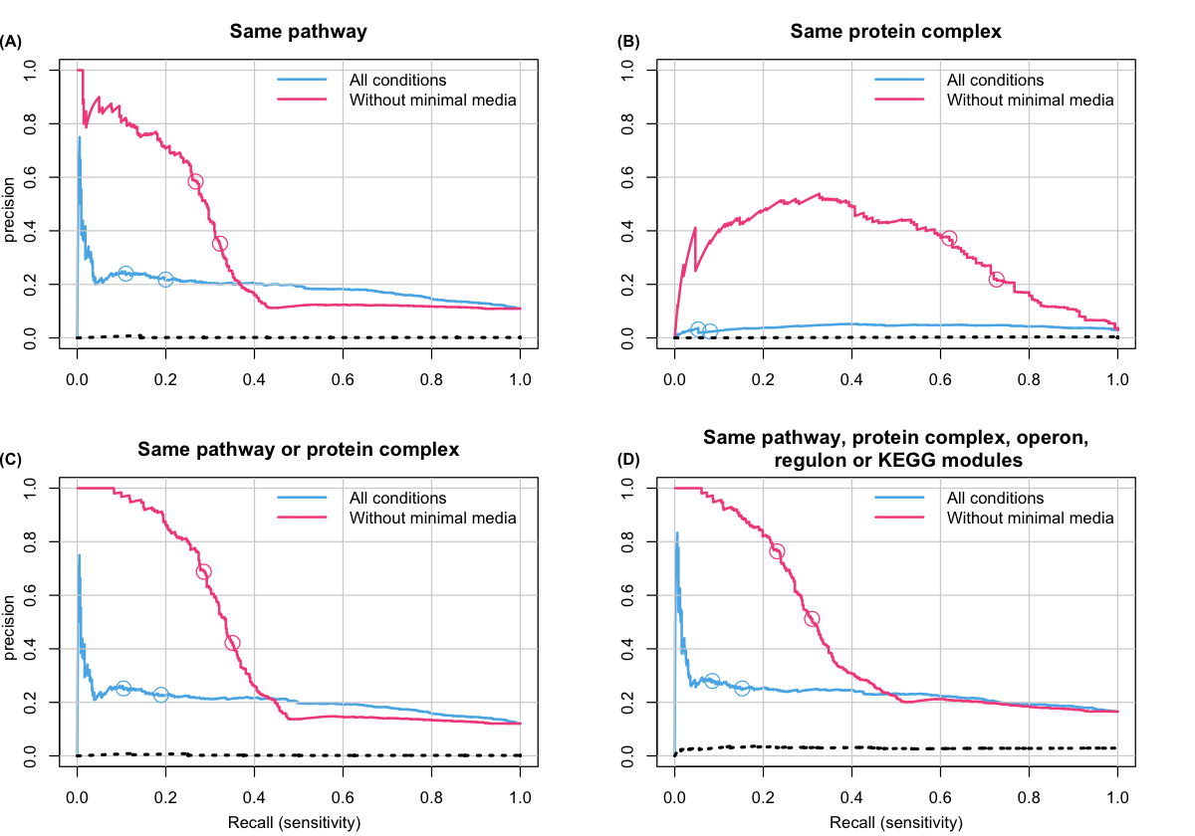
250th
500th
250th
250th
500th
500th
250th
500th
250th
250th
500th
500th
250th
250th
500th
500th
FIGURE S6. Precision-recall curves when phenotypic profile similarity is determined by |PCC|. Gene pairs were ranked from high to low similarity based on |PCC| using either all growth conditions (blue line) or after minimal media conditions were excluded (red line). Precision and recall were then calculated for the 5,000 top-ranked gene pairs. The panels show precision-recall curves for gene pairs annotated to either (A) the same EcoCyc pathway, (B) the same heteromeric protein complex, (C) the same pathway or complex, or (D) gene pairs co-annotated in any of annotation sets 1 through 5. Circles indicate the positions of the 250th and 500th top-ranked gene pairs. The dashed lines show precision for randomly ordered gene pairs generated as described in the Methods (negative control). The areas under the curve for randomly ordered gene pairs, for all growth conditions, and when minimal media conditions are excluded are: (A) 0.11, 0.19, and 0.50, respectively; (B) 0.03, 0.04, and 0.31, respectively; (C), 0.12, 0.20, and 0.57, respectively; and (D) 0.16, 0.24, and 0.47, respectively.

