Slide 1
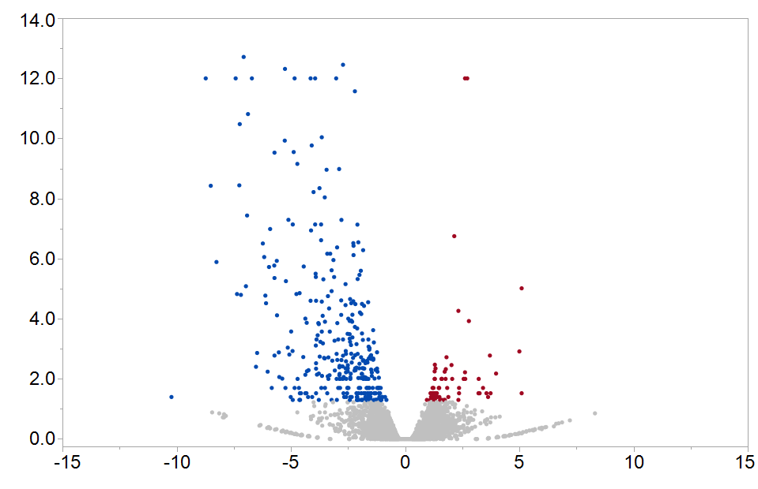
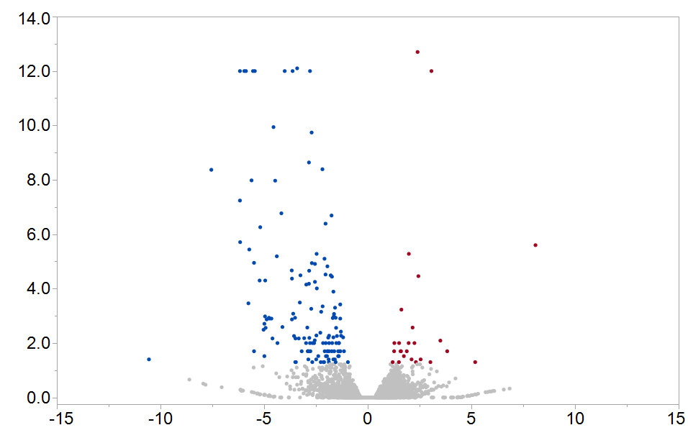
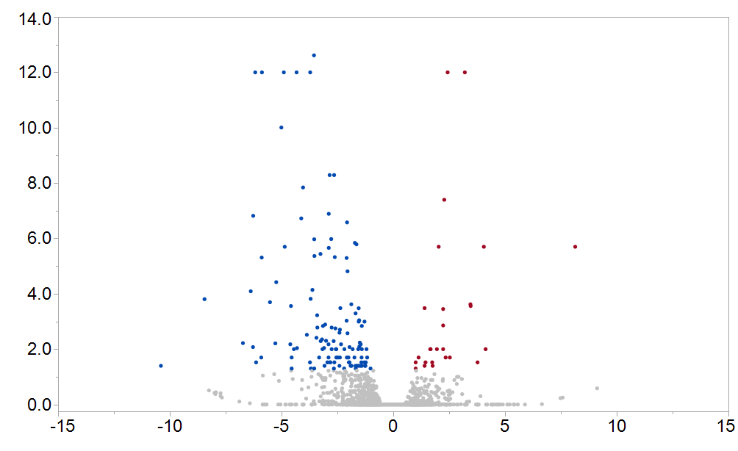
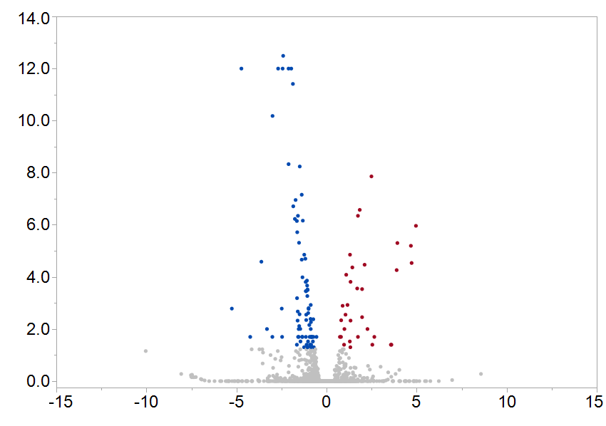
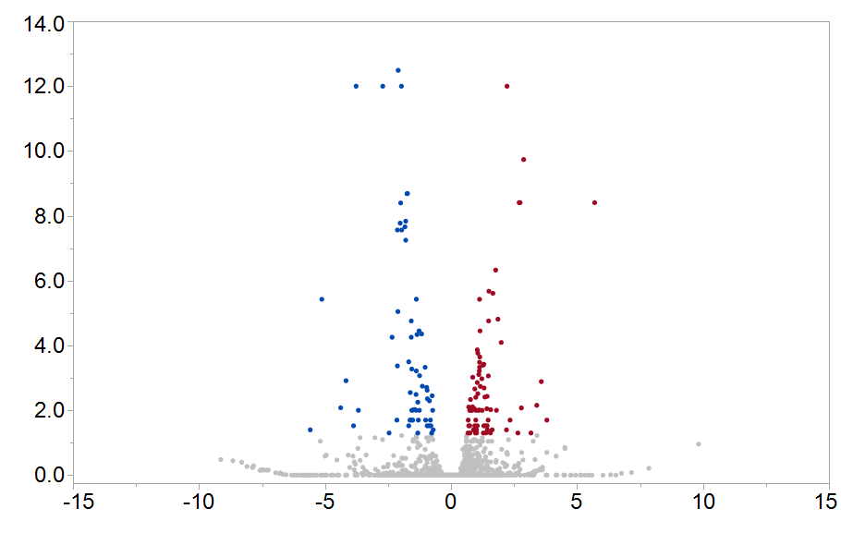
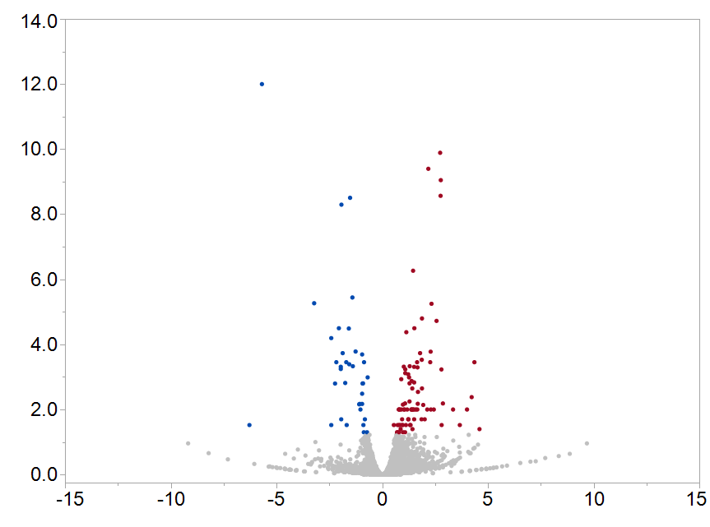
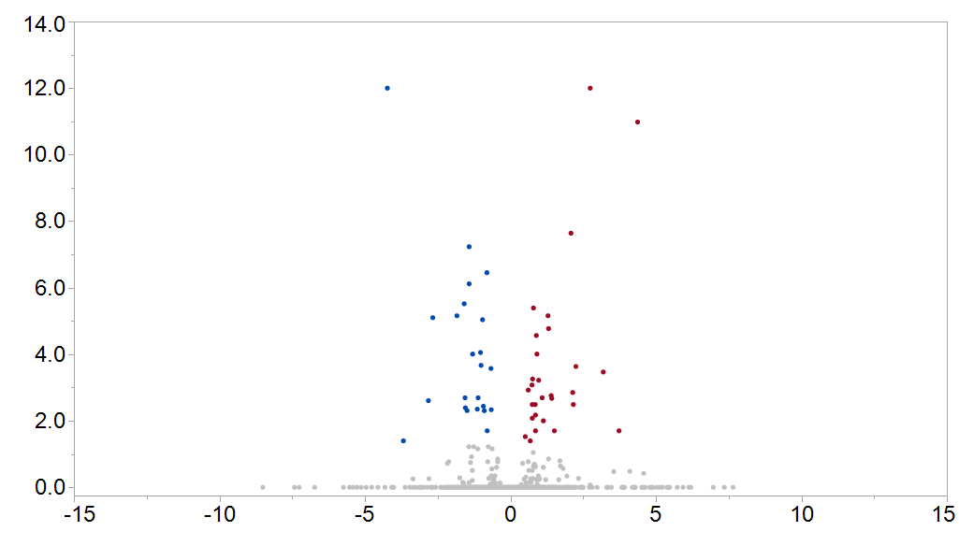
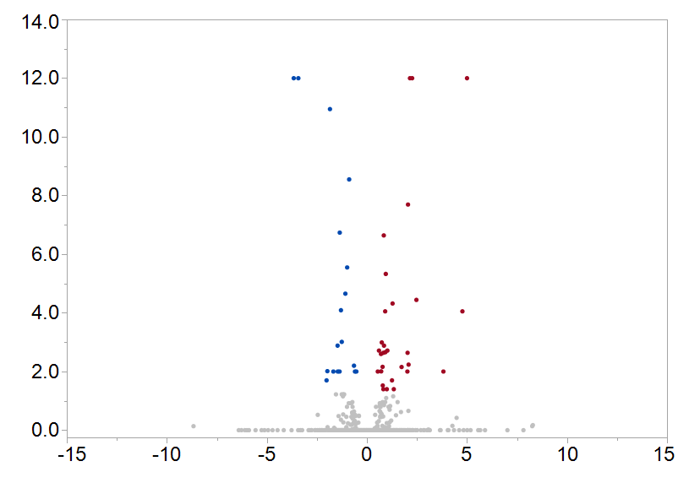
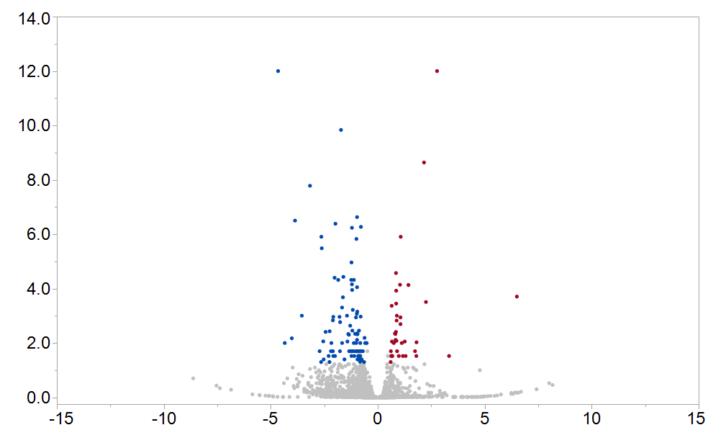
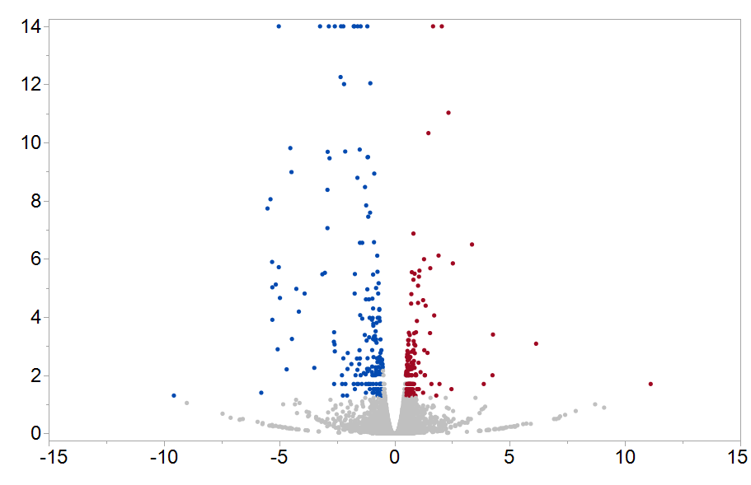
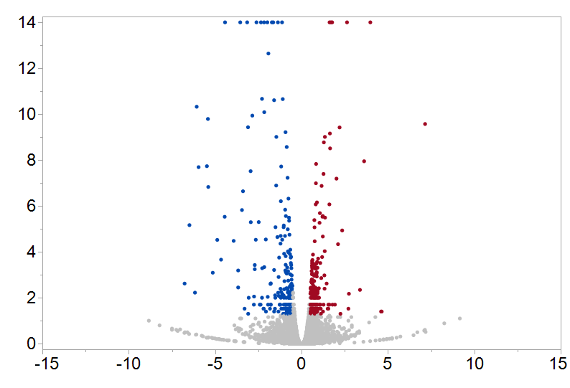
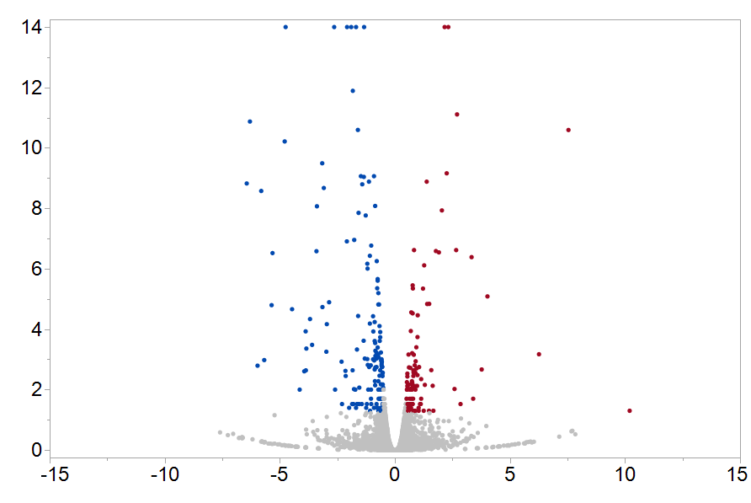
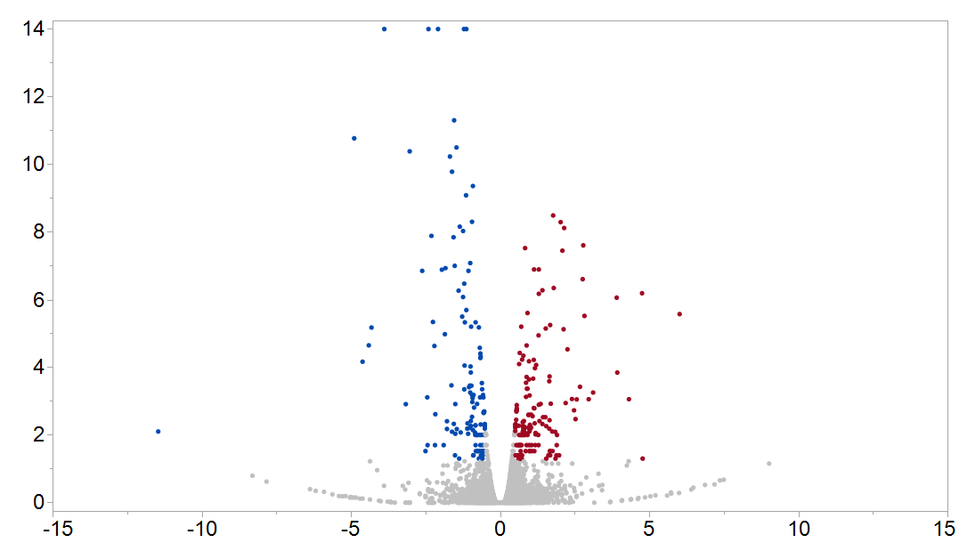
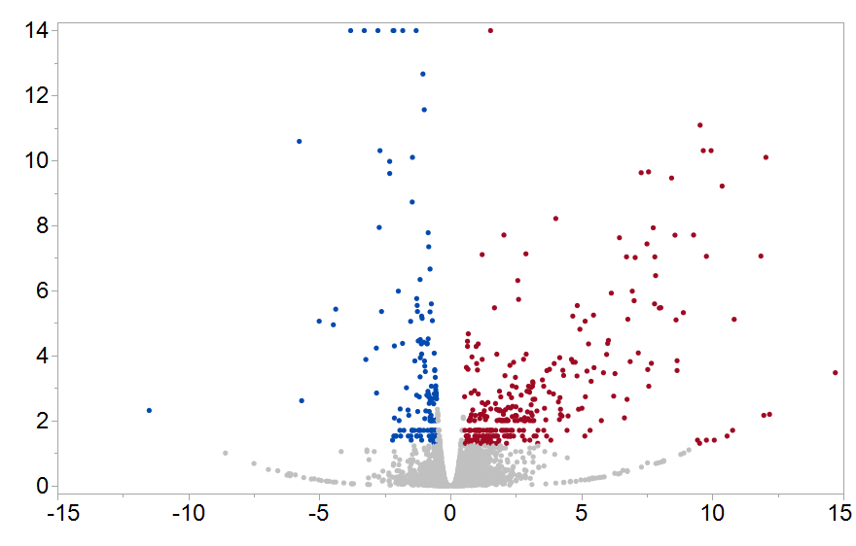
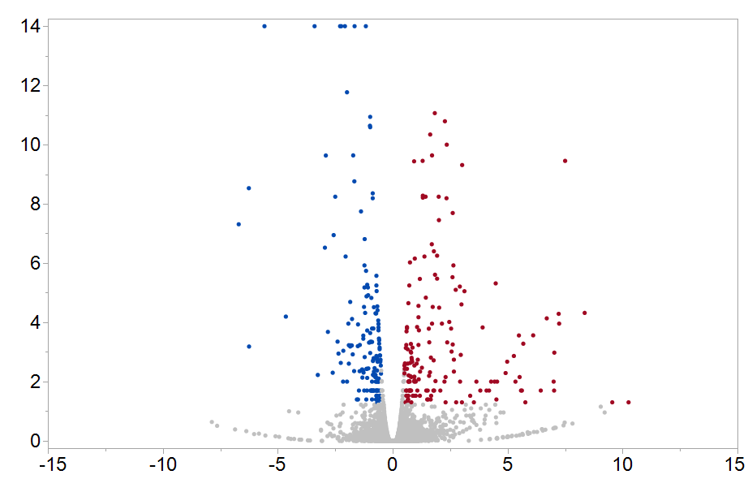
WT A31P R820W
Larvae
Females
Exercised
Females
Males
Exercised
Males

Slide 2
Figure S3. Volcano plots. Differential expression analysis of genes in the MYBPC3 transgenic lines (WT, A31P, and R820W) normalized to the control line (Attp2), expressed in cardiac tissue. Data sets are shown for larvae and for exercised and non-exercised adult flies. The X-axis shows the magnitude of change in expression (Log2Fold-change) and the Y-axis the statistical significance (-Log10(FDR P-value)). Blue dots represent genes that are significantly down-regulated and red dots represent genes that are significantly up-regulated. Gray dots represent unchanged genes. See File S2 for the raw data.

