Slide 1
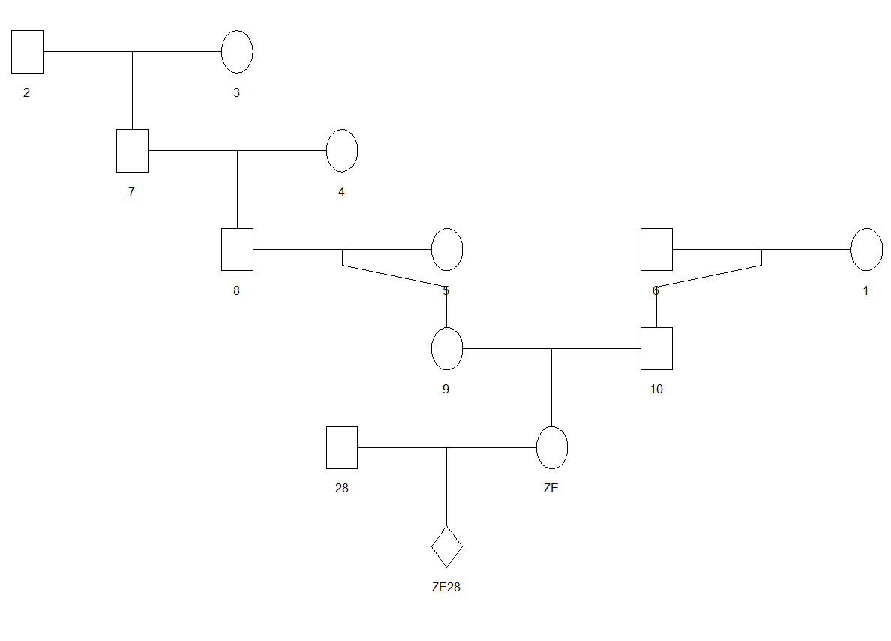
Supplementary Figure S1: Pedigree structure of the ZE28 family. Female and male parents are represented by circles and squares, respectively.

