Slide 1
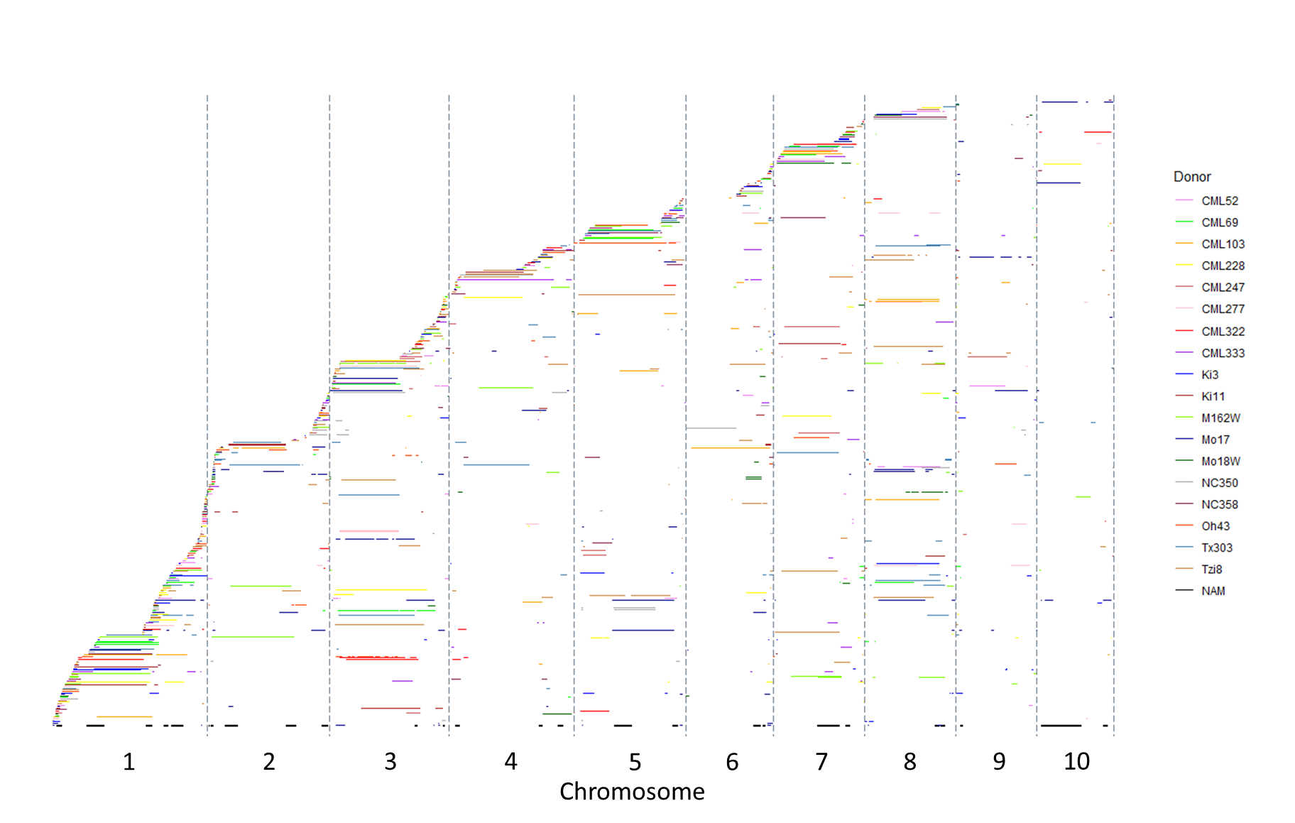
Figure S2. Tiling path of introgressions from nNIL library across the maize genome with introgression donors color-coded to indicate specific donor contributions. NILs were ordered along the y-axis based on the first introgression start site.

