Slide 1
A.
B.
Ac tester X
p1-vv-9D9A*/p1-ww-id1
100% of kernels are weakly or non-spotted
Ac tester X
p1-vv-9D9A*/+
100% of kernels are weakly or non-spotted
Notes:
Figure S1. Genetic crosses to test the maintenance of Ac repression initiated by p1-ww-id1.
A. The ear from the cross of Ac tester by p1-vv-9D9A*/p1-ww-id1. 100% of the kernels show fine spots or no spots on the aleurone, indicating that the silencing of Ac by p1-ww-id1 was efficiently maintained in the first generation following segregation of p1-ww-id1 from p1-vv-9D9A*. Asterisk indicates silenced Ac.
B. The ear from the cross of Ac tester by p1-vv-9D9A*/+. 100% of the kernels show fine spots or no spots on the aleurone, indicating that the silencing of Ac by p1-ww-id1 was efficiently maintained for the second generation in the absence of p1-ww-id1.

Slide 2
A.
B.
Ac tester X
p1-vv-9D9A*/p1-ww-id4
21.3% of kernels are heavily-spotted
X Ac tester
p1-vv-9D9A*/+
36.1% of kernels are heavily-spotted
Notes:
Figure S2. Genetic crosses to test the maintenance of Ac repression initiated by p1-ww-id4.
The ear from the cross of Ac tester by p1-vv-9D9A*/p1-ww-id4. 78.7% of kernels show fine spots or no spots on the aleurone and 21.3% of kernels show heavy spots on the aleurone. Asterisk indicates silenced Ac.
The ear from the cross of Ac tester by p1-vv-9D9A*/+. 63.9% of kernels show fine spots or no spots on the aleurone, and 36.1% of kernels show heavy spots on the aleurone.

Slide 3
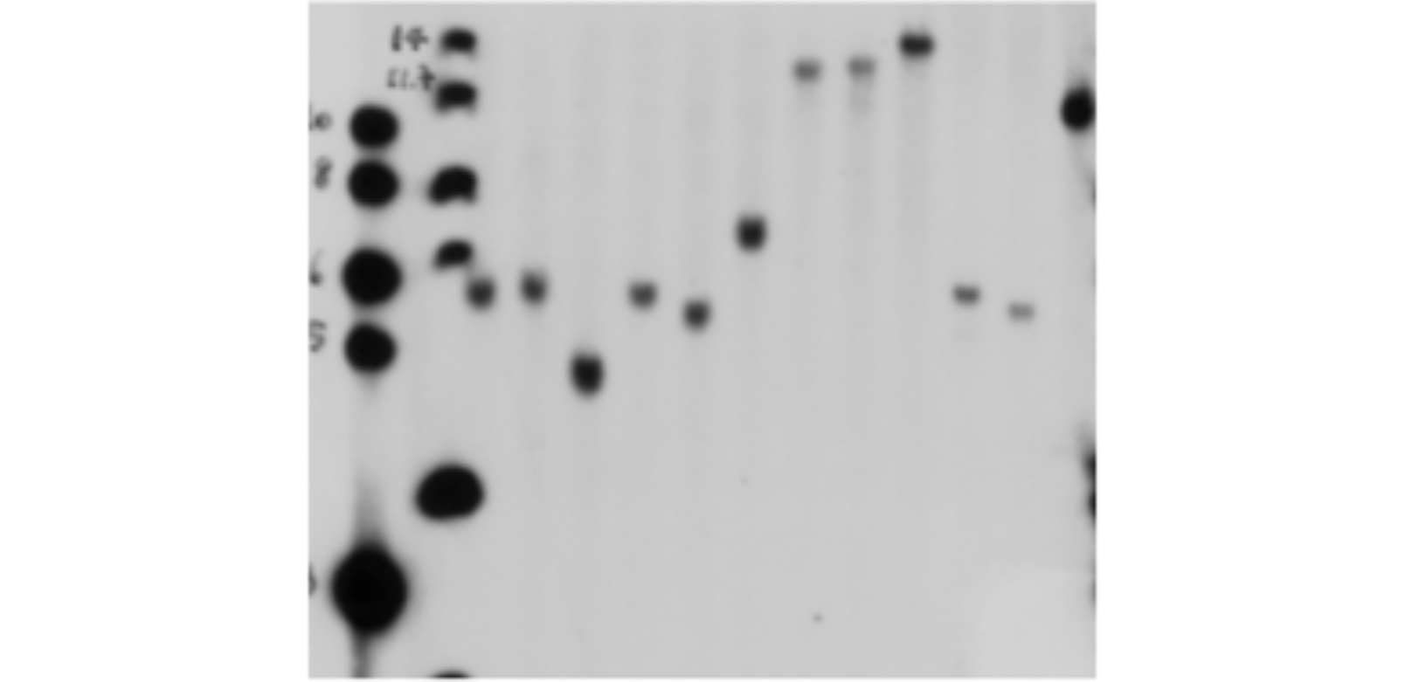
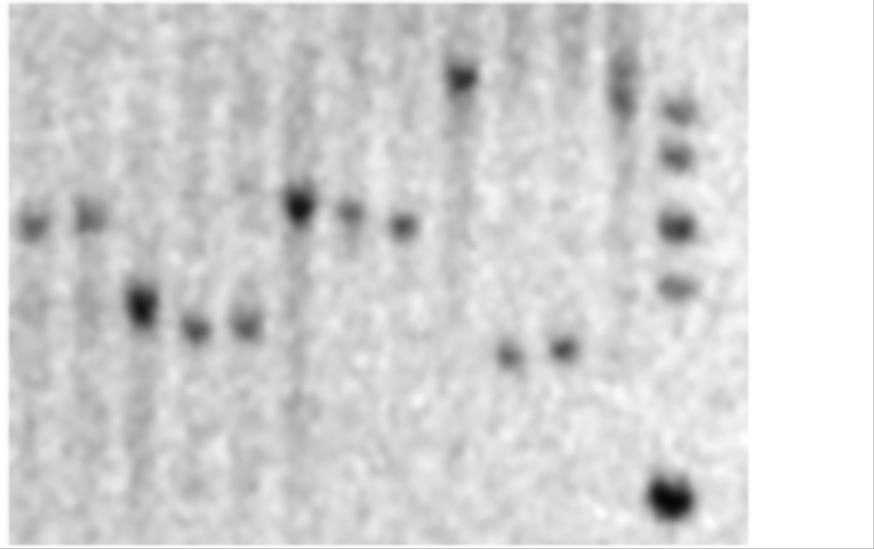
A.
B.
C.
(kb)
10
8
6
5
3
L1 L2 1 2 3 1 2 3 1 2 3 1 2 3
1 2 3 1 2 3 1 2 3 1 2 3 L
14
11.7
8
6
4
(kb)
10
8
6
5
3
Lane L: Ladder
Lane 1: B73
Lane 2: P1-vv-9D9A
Lane 3: p1-ww-id1
SspI ScaI EcoRI PstI
SspI BglI PstI SalI
Probe | 1P |  |  |  | 1D
Restriction | SspI | ScaI | EcoRI | PstI | SspI | BgII | PstI | SalI
Positions in Ac (bp) | 1826 | 1842 | 2486 | --- | 1826 | 729 | --- | ---
Expected band (kb) | 4.7 | 6.4 | 7.6-9.6 | 5+CI | 4.7 | 6.6 | 5+CI | 3.8+CI
Observed band (kb) | ~4.7 | ~6.4 | 14 | 11.7 | ~4.7 | ~6.6 | ~(10-12) | ~(10-12)
Notes:
Figure S3. Southern blot analysis of the structure of Composite Insertion of p1-ww-id1.
Schematic structure of the p1-ww-id1 allele with restriction sites (vertical lines) and probes (hatched boxes marked "1P" and "1D") indicated.
The Southern blot result of genomic DNAs from B73 (Lane 1), p1-vv-9D9A (Lane 2), and p1-ww-id1 (Lane 3), digested with the indicated enzymes and hybridized with probe 1P (left panel) and 1D (right panel).
Table of expected and observed band sizes when the restriction sites are included in the Composite Insertion. Enzyme Abbreviation: E: EcoRI; Sc: ScaI; P:PstI; Sp: SspI; Sl: SalI; B: BglI; N: NcoI.

Slide 4
A.
B.
C.
(kb)
10
8
6
5
3
L 1 2 4 1 2 4 1 2 4 1 2 4
Lane L: Ladder
Lane 1: B73
Lane 2: p1-vv-9D9A
Lane 4: p1-ww-id4
ScaI EcoRI PstI NcoI
Probe | 4PD
Restriction | ScaI | EcoRI | PstI | NcoI
Positions in Ac (bp) | 1842 | 2486 | --- | ---
Expected band (kb) | 5 from P side 3.8 from D side | 9 from P side 3.8 from D side | 8 from duplication; (3.7+CI) from CI | 5.6 from duplication; (3.5+CI) from CI
Observed band (kb) | 5 and ~3.8 | ~(12-13) and ~3.8 | 8 and ~(10-12) | ~5.6 and ~(10-12)
Notes:
Figure S4. Southern blot analysis of the structure of Composite Insertion in p1-ww-id4.
A. Schematic structure of the p1-ww-id4 allele with restriction sites (vertical lines) and probes (hatched boxes labeled "4P" and "4D") indicated. Enzyme Abbreviation: E: EcoRI; N: NcoI; P: PstI; Sc: ScaI.
B. Southern blot result of genomic DNA from B73 (Lane 1), p1-vv-9D9A (Lane 2), and p1-ww-id4 (Lane 4), digested with the indicated enzymes and hybridized with probe 4PD.
C. Table of expected and observed band sizes when the restriction sites are included in the Composite Insertion. Enzyme Abbreviation: E: EcoRI; Sc: ScaI; P:PstI; Sp: SspI; Sl: SalI; B: BglI; N: NcoI.

Slide 5
Notes:
Figure S5. The gene expression data of target genes where Composite Insertions of p1-ww-id1 and p1-ww-id4 are located. Data are from (Wang et al. 2009).

Slide 6
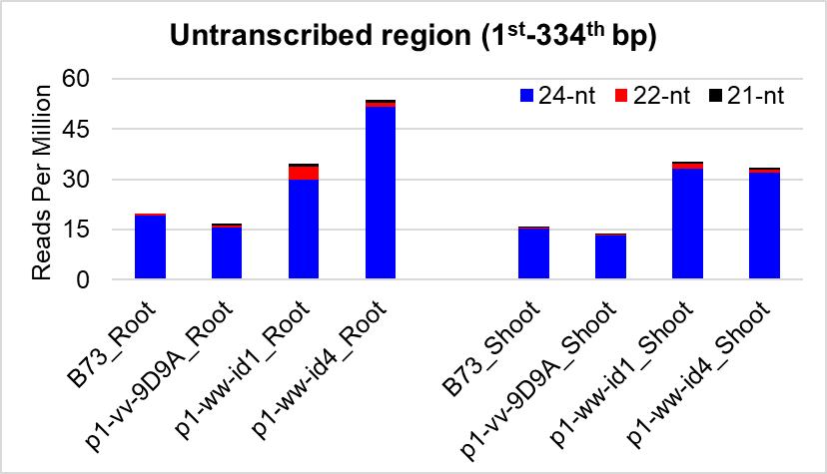
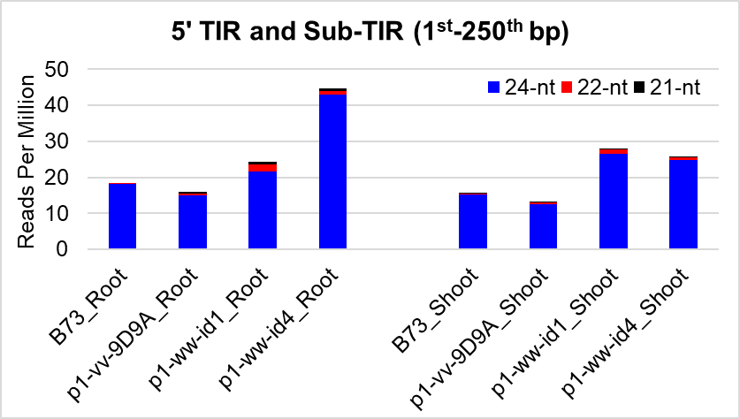
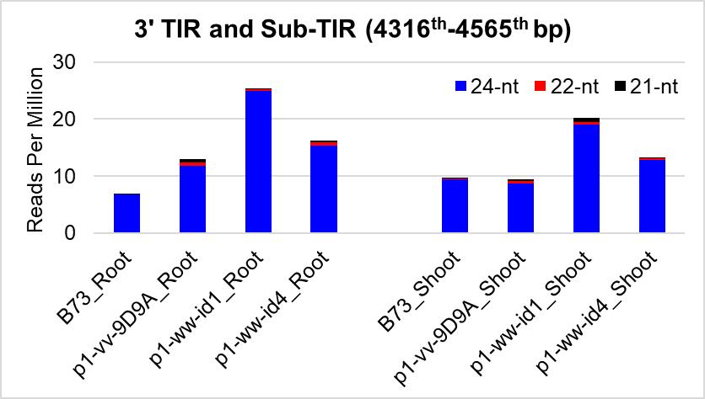
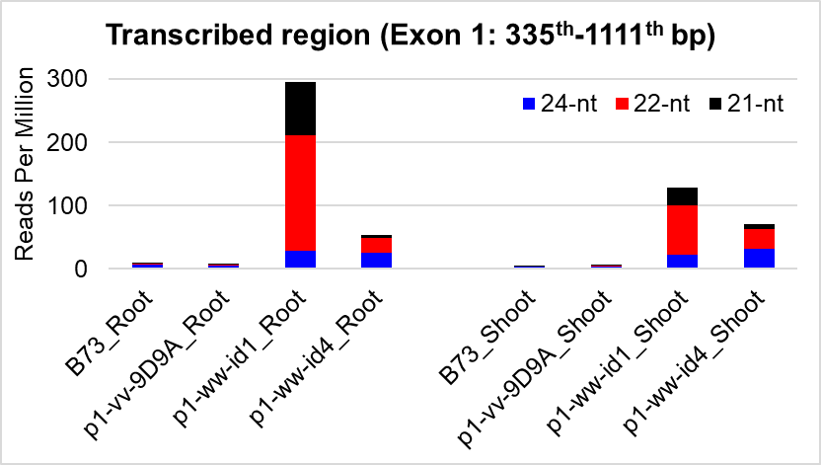
A.
5’TIR/Sub-TIR
3’TIR/Sub-TIR
Untranscribed region
Transcribed region
B.
C.
D.
E.
Notes:
Figure S6. Small RNA read counts of specific regions of Ac.
Schematic structure of Ac. Filled and open triangles indicate Ac 5’ and 3’ termini, respectively. Filled boxes are exons, hatched boxes indicate sub-terminal regions. The arrow marks the transcription start site of Ac, and numbers indicate the nucleotide positions within Ac, including untranscribed region (1-334 bp; 5’ TIR/Sub-TIR from 1 – 250 bp); transcribed region (335 – 4315; exon 1 from 335 – 1111 bp); 3’ TIR/Sub-TIR (4316 – 4565 bp).
B-E. Small RNA Reads Per Million that exactly match the Ac sequence of the indicated regions of Ac.

Slide 7
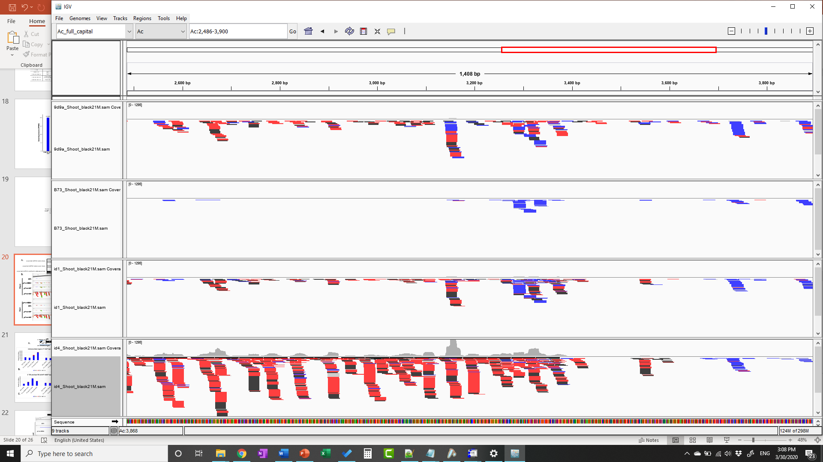
Stem loop
B.
expected dsRNA (stem-loop)
expected dsRNA (stem-open loop)
expected dsRNA matched to Ac sequences
2486 3900
p1-vv-9D9A
B73
p1-ww-id1
p1-ww-id4
p1-vv-9D9A
B73
p1-ww-id1
p1-ww-id4
Shoot
Root
Notes:
Figure S7. Small RNAs mapped to the loop region of p1-ww-id4, visualized by the Integrative Genomics Viewer.
A. Diagram of expected dsRNA from p1-ww-id4 including predicted stem-loop structure (top), and stem-open loop structure to show extent of Ac sequence included in loop (middle). Lower map shows structure of Ac including exons 1 – 5 (black boxes), and predicted loop positions at 2486 – 3900.
B. Small RNA reads mapped to Ac positions 2486 – 3900 in shoot and root tissues of the indicated genotypes. Black, red and blue indicate 21-, 22-, and 24-nt small RNAs, respectively. Compared to genotypes that do not contain a loop structure (B73, progenitor allele p1-vv-9D9A and p1-ww-id1), the p1-ww-id4 allele shows an accumulation of 21-22 nt small RNAs in both shoot and root. The small RNAs in p1-ww-id4 extend from 2486 to ~3400 in Ac, which is similar to the size of loop predicted by genomic Southern blot (2486 – 3900). The ~500 bp difference may due to the low resolution of genomic Southern blot in estimating fragment sizes.

Slide 8
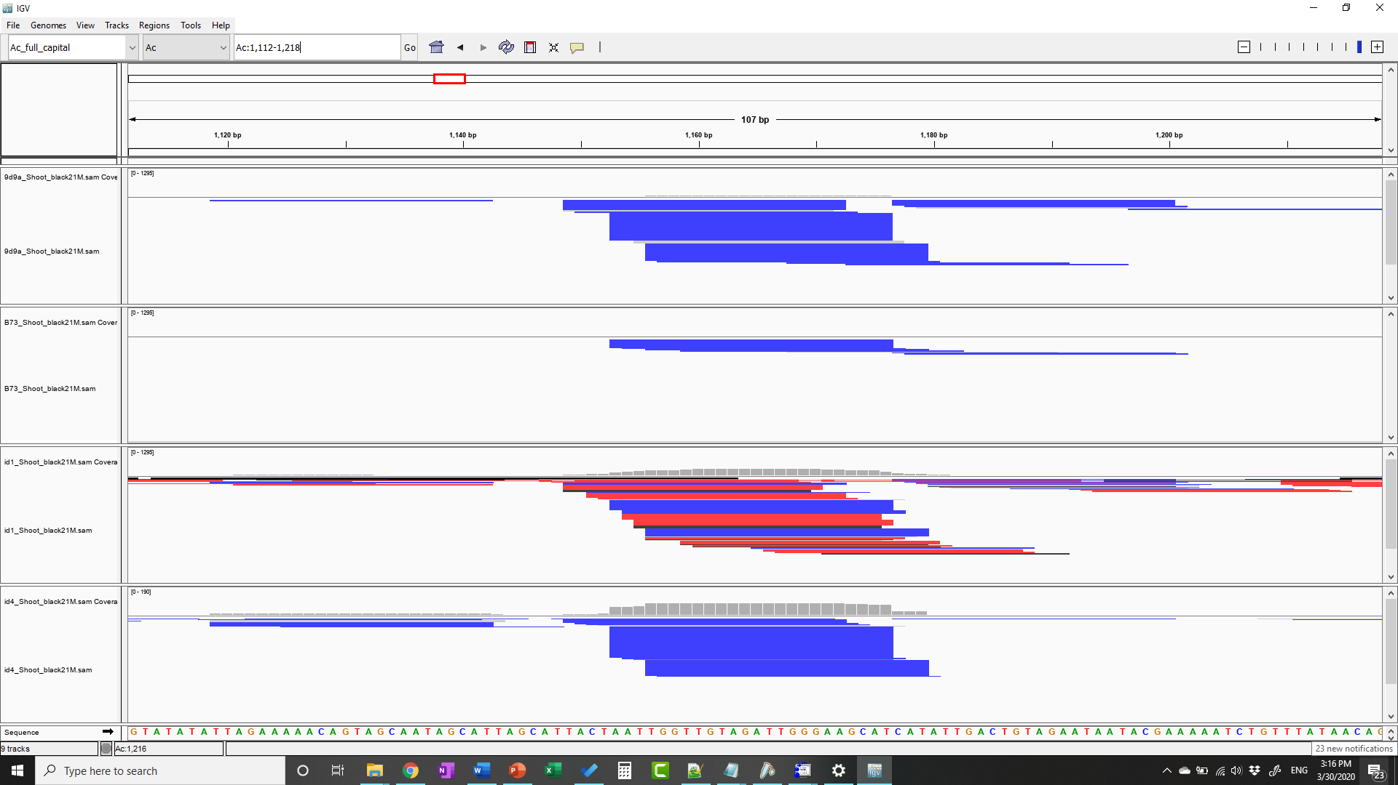
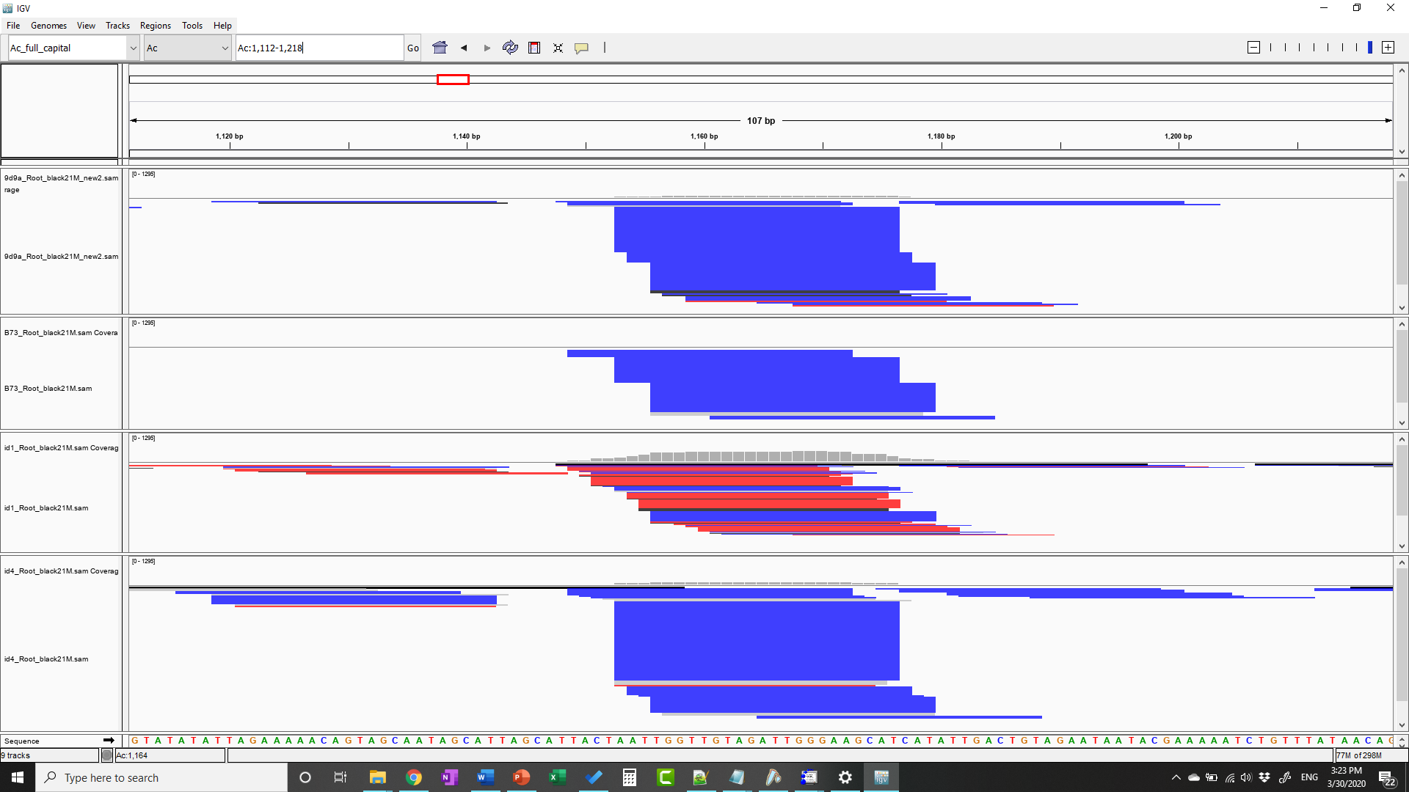
B.
1112th 1218th
p1-vv-9D9A
B73
p1-ww-id1
p1-ww-id4
p1-vv-9D9A
B73
p1-ww-id1
p1-ww-id4
Shoot
Root
Notes:
Figure S8. Small RNAs mapped to Ac intron 1 (position 1112th -1218th bp), visualized by the Integrative Genomics Viewer. The y axis of the coverage track was standardized to the same scale for each sample. Black, red and blue indicate 21-, 22-, and 24-nt small RNAs, respectively. The 21- and 22-nt small RNAs are enriched in both root and shoot of p1-ww-id1, consistent with the intron-containing cDNA that was detected by RT-PCR. The extent of small RNA coverage also matches the size of unspliced intron 1 in p1-ww-id1. Unexpectedly, p1-ww-id4 does not show a similar accumulation of 21- and 22-nt sRNA, even though it does produce dsRNA including the unspliced Ac intron 1 based on RT-PCR and dsRNA protections assays (Figure 6). The reason for this difference is unknown.

