Slide 1
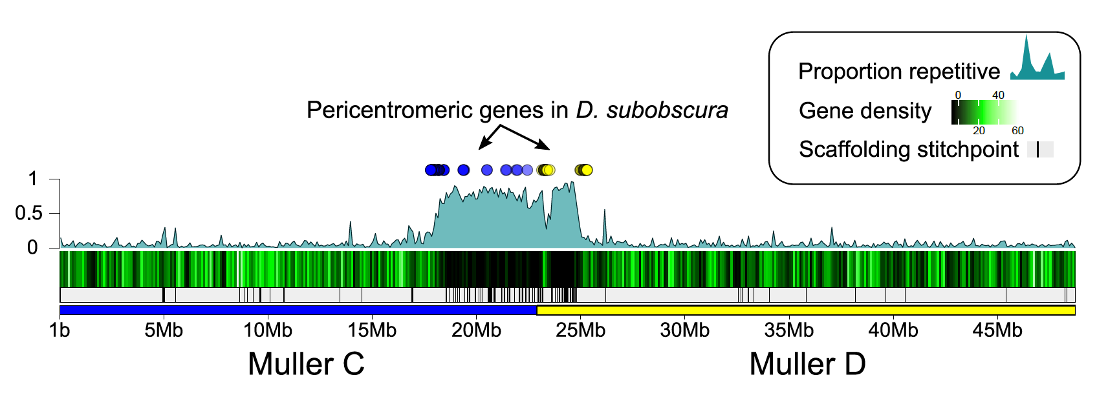
Figure S5. Genomic location of D. subobscura pericentromeric orthologs from Muller C (blue dots) and D (yellow dots) on the fused Muller CD of D. bifasciata.

