Slide 1
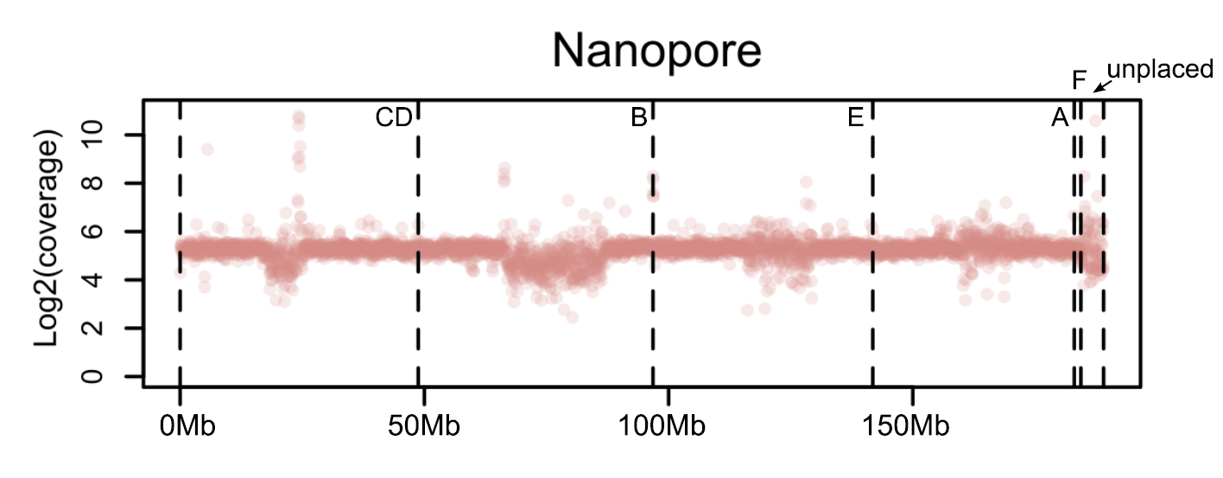
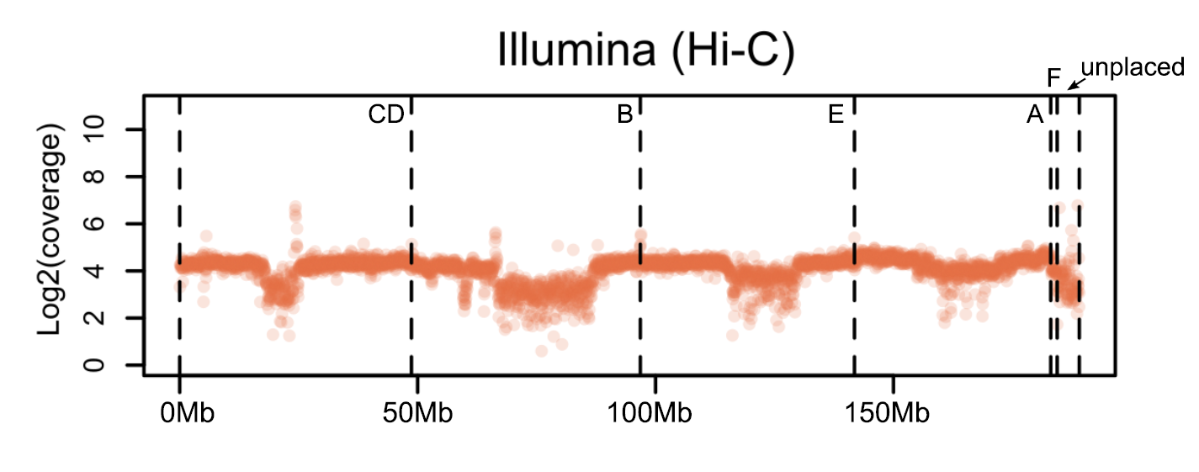
Figure S2. Illumina and Nanopore sequencing coverage over the draft D. bifasciata genome assembly.

