Slide 1
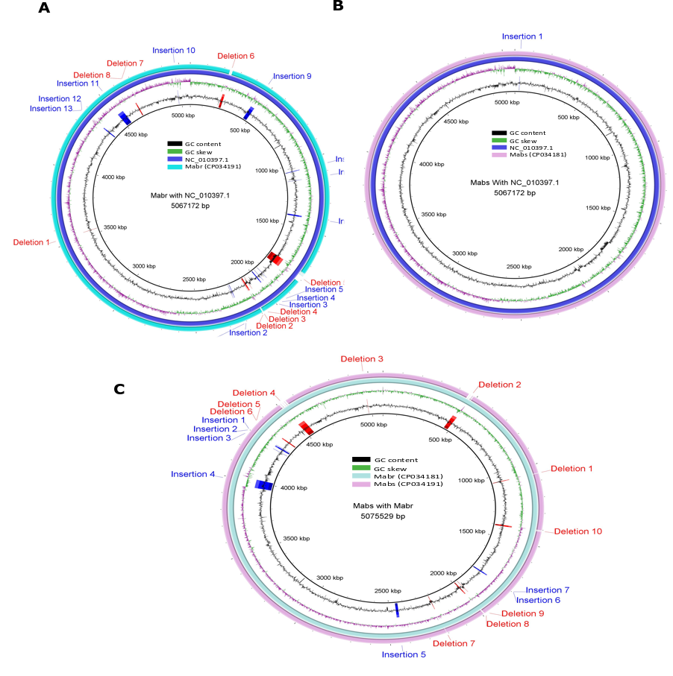
Figure S6: Circular visualization of insertions and deletions in Mab^{R} (CP034191) and Mab^{S} (CP034181). BLAST Ring Image Generator (BRIG v0.95 and NCBI BLAST+) used for comparison of Mab^{R} genome (CP034191) with M. abscessus reference genome (NC_010397.1) (A), Mab^{S} (CP034181) genome with M. abscessus reference genome (NC_010397.1) (B), and Mab^{S} (CP034181) with Mab^{R} (CP034191) (C).

