Slide 1
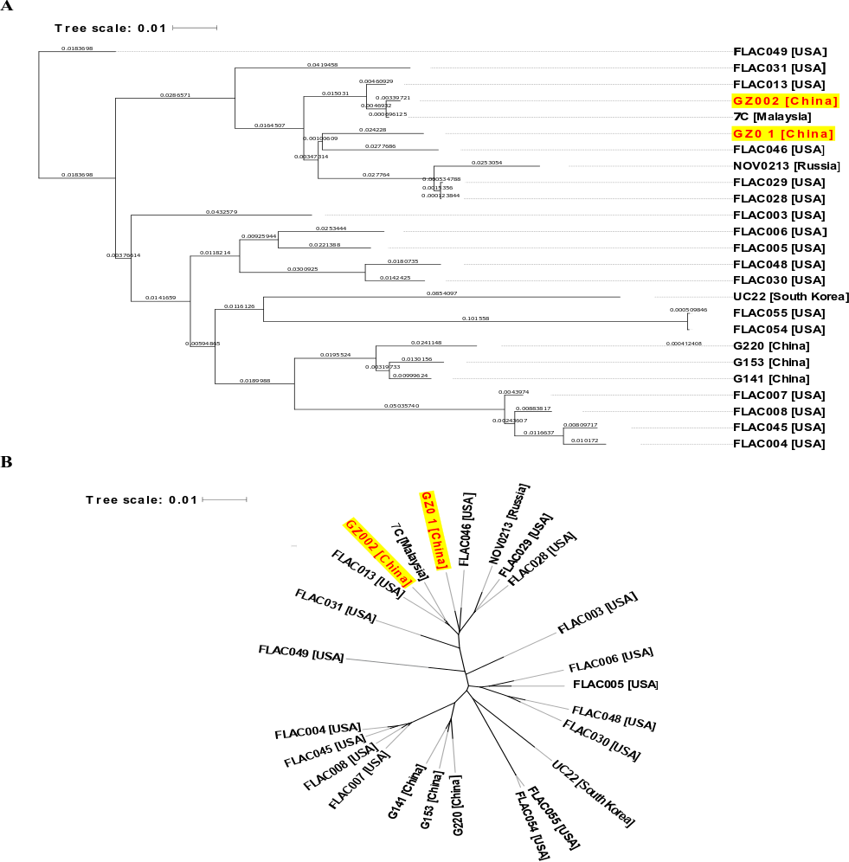
Figure S3: The pan-genome phylogeny of 25 complete genome sequences of M. abscessus. Branch length indicates evolutionary distances between the different branches as indicated by the given scale, while the country of isolation is also mentioned in the leaf label along with strain name (A). The pan-genome phylogeny of 25 complete genome sequences of M. abscessus displayed as unrooted (B).

