Slide 1
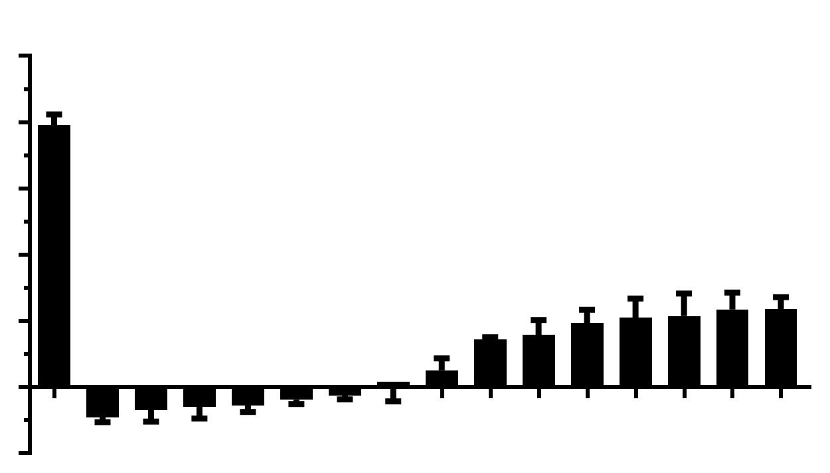
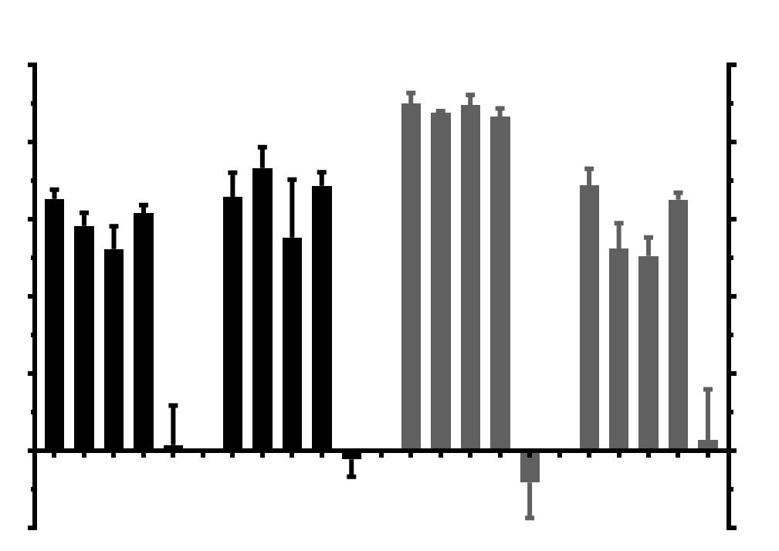
A
1.0
MeSa avoidance index
0.8
0.6
0.4
***
***
***
***
***
0.2
***
***
***
0.0
***
***
***
***
***
***
***
WT
-0.2
unc-80(mac385)
unc-80(mac381)
unc-80(mac382)
unc-80(mac388)
unc-79(mac393)
unc-80(mac386)
unc-80(mac390)
unc-80(mac394)
unc-80(mac380)
unc-80(mac391)
unc-80(mac384)
unc-80(mac379)
mac387
unc-79(mac389)
unc-79(mac383)
B
Attraction
Avoidance
1.0
Diacetyl
1.0
Avoidance index
2-nonanone
0.8
Benzaldehyde
Attraction index
1-octanol
0.8
0.6
0.6
0.4
0.4
0.2
***
***
0.2
0.0
***
***
0.0
WT
WT
WT
WT
-0.2
-0.2
unc-79(mac383)
unc-80(mac379)
mac387
unc-79(mac383)
unc-79(mac383)
unc-79(mac383)
nca-2(gk5); nca-1(gk9)
unc-80(mac379)
unc-80(mac379)
unc-80(mac379)
mac387
nca-2(gk5); nca-1(gk9)
nca-2(gk5); nca-1(gk9)
nca-2(gk5); nca-1(gk9)
mac387
mac387
Notes:
Figure 1. Chemotaxis of mutants with defective MeSa avoidance responses.
(A) MeSa avoidance indexes of isolated mutants. (B) Responses of representative mutants to volatile repellents and attractants, including repellents 1-octanol and 2-nonanone and attractants diacetyl and benzaldehyde. Each dataset was based on three biological replicates. Statistics: Bonferroni multiple comparison with one-way ANOVA. ***, p<0.001. Error bars: standard error of mean.

Slide 2
A
B
60
unc-79(mac383)
unc-80(mac379)
nca-2(gk5); nca-1(gk9)
1.0
P_{L}unc-79::unc-79a_gDNA
# # #
MeSa avoidance index
5 kb
Body bends/min
48
# # #
# # #
# # #
0.8
P_{S}unc-79::unc-79a_gDNA
# # #
# # #
***
2 kb
36
***
0.6
Punc-79b::unc-79b_gDNA
***
12 kb
24
0.4
Punc-80::unc-80_gDNA
***
3.6 kb
12
***
0.2
Pnca-1::nca-1_gDNA
3.1 kb
0
0.0
Pnca-2::nca-2::gDNA
WT
3.1 kb
-12
No Tg
-0.2
No Tg
No Tg
nca-1 Tg +
nca-2 Tg
Pnca-1::nca-1_gDNA
P_{S}unc-79a::unc-79a_gDNA
Pnca-2::nca-2_gDNA
P_{L}unc-79a::unc-79a_gDNA
Punc-79b::unc-79b_gDNA
Punc-80::unc-80_gDNA
C
60
***
1.0
Body bends/min
***
***
MeSa avoidance index
48
***
0.8
***
36
***
0.6
24
***
***
0.4
12
# # #
# # #
***
***
0.2
***
***
# # #
***
# # #
***
***
# # #
0
# # #
***
0.0
WT
-12
unc-79(mac383);
unc-80(mac379)
nca-1(e625gf);
unc-80(mac379)
-0.2
unc-79(mac383);
nca-1(e625gf)
nca-1(gk9);
nlf-1(mac409)
nca-2(gk5);
nlf-1(mac409)
nca-1(gk9)
nca-2(gk5);
nca-1(gk9)
nlf-1(mac409)
nca-1(e625gf);
nlf-1(mac409)
nca-2(gk5)
unc-80(mac379)
unc-79(mac383)
Notes:
Figure 2. The effects of unc-79, unc-80 and nca mutations on MeSa avoidance and locomotion.
(A) Transgene structures. Empty boxes indicate promoters. Black boxes indicate exons of each transgene. The length of each promoter is indicated. (B) Transgene rescue of the defective locomotion and the defective MeSa avoidance of unc-79, unc-80 and nca loss-of-function mutants. The locomotion (body bends/min, blue columns) and MeSa avoidance indexes (red columns) were based on two independent transgenic lines. For locomotion, 20 animals were assayed for each line with 40 animals assayed in total. For MeSa avoidance indexes, each dataset was based on three biological replicates for each line with six in total. Statistics: Student’s t-test and Statistics: Bonferroni multiple comparison with one-way ANOVA. *** or ###, p<0.001. Error bars: standard error of mean. Comparisons were made between transgenic lines and their respective loss-of-function mutants. (C) The locomotion (body bends/min, blue columns, 40 animals per strain) and MeSa avoidance indexes (red columns, three to six biological replicates) of single and double mutants. Genotypes are labeled at bottom. Statistics: Bonferroni multiple comparison with one-way ANOVA. *** or ###, p<0.001. Error bars: standard error of mean. Note: data for wildtype, unc-79(lf), unc-80(lf) and nca(lf) animals were repeatedly used for comparison purpose.

Slide 3
A
A
V
AVA
AVE
RIH?
AVG
VNC
Punc-80::GFP
Pnmr-1::mCherry
Merged
NR
10 μm
10 μm
10 μm
B
I3
RMD
NR
Punc-80::GFP
10 μm
Pmgl-1::mCherry
10 μm
Merged
10 μm
C
I4
Punc-80::GFP
10 μm
Pmgl-1::mCherry
10 μm
Merged
10 μm
D
NSM
NR
Punc-80::GFP
10 μm
Pmgl-1::mCherry
10 μm
Merged
10 μm
Notes:
Figure 3. Neuronal double-labeling identified a subset of unc-80-expressing neurons.
(A) GFP expression driven by the unc-80 promoter (left panel, Punc-80), mCherry driven by the nmr-1 promoter (middle panel, Pnmr-1) and the merged image (right panel) showing GFP expression in AVA, AVE and AVG neurons and probably in the RIH neuron. (B, C, D) GFP driven by Punc-80 (left panels), mCherry driven by Pmgl-1 (middle panels) and the merged images showing GFP expression in RMD and I3 (B, right panel), I4 (C, right panel) and NSM (D, right panel) neurons. VNC: ventral nerve cord. NR: nerve ring. A: anterior. V: ventral. Results were based on three independent transgenic lines. Pictures were taken from a line with the most robust expression of reporters.

Slide 4
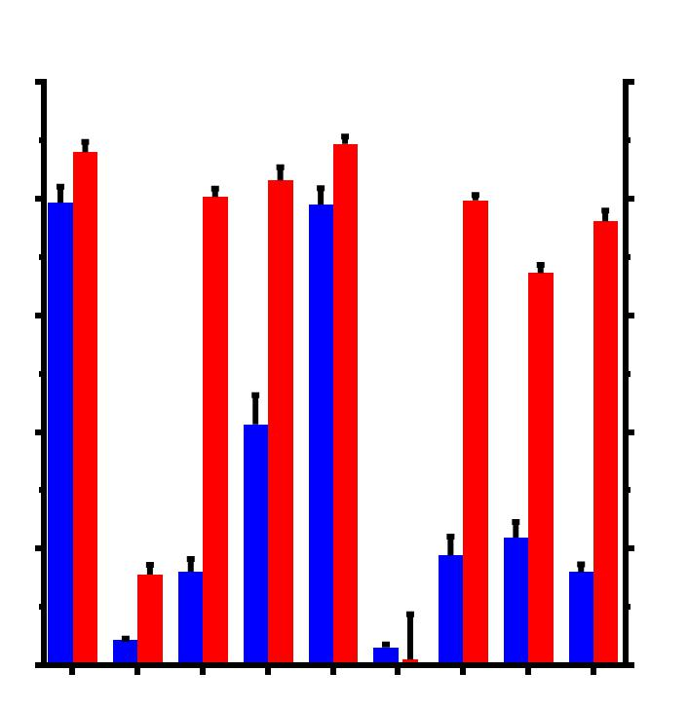
A
unc-80(mac379)
MeSa avoidance index
Body bends/min
60
1.0
# # #
# # #
48
# # #
0.8
36
# # #
# # #
# # #
0.6
***
24
***
0.4
***
12
0.2
0
0
WT
No Tg
Punc-80
Pnlf-1
Pnmr-1
Pglr-1
Pflp-1/
Pflp-18/
Punc-7b
Pflp-1
Pflp-18
Punc-7b
Pmgl-1
Psra-11
P_{L}unc-79a
P_{S}unc-79a
AVA
AVE
…
AVA
AVD
AVE
AVG
RIM
AVA
AVD
AVE
AVG
RIM
...
AVA
AVE
AVK
RIG
RMG
...
AVA
AIY
RIG
RIM
AVD
AVG
AVJ
AVK
RMD
...
AIA
AIY
RMD
I3
I4
NSM
AIA
AIY
AVB
Promoter::
unc-80_cDNA
AVA
AVE
AVG
...
B
MeSa avoidance index
60
PU6::unc-80_sgRNA#1+#2
PU6::unc-79_sgRNAs#1+#2
1.0
Body bends/min
48
0.8
36
0.6
24
***
0.4
12
***
***
***
0.2
# # #
***
***
***
# # #
0
0
WT
Punc-119
Pnmr-1
Punc-80
Punc-119
P_{L}unc-79a
P_{S}unc-79a
Promoter
::Cas9
unc-80(mac379)
Pan-
neuronal
AVA
AVD
AVE
AVG
RIM
Pan-
neuronal
unc-79(mac383)
Notes:
Figure 4. Neuron-specific transgene rescue and neuron-specific knockdown experiments.
(A) The locomotion (body bends/min, blue columns, 20 animals per transgenic line, 40 animals in total) and MeSa avoidance indexes (red columns) of unc-80(lf) transgenic lines expressing an unc-80 cDNA transgene driven by different promoters compared to unc-80(lf) mutants. unc-80-expressing neurons are highlighted in blue. Promoter types and the corresponding neurons are labeled at bottom. Results were based on two independent transgenic lines. (B) The locomotion (body bends/min, blue columns, 20 animals per transgenic line, 40 animals in total) and MeSa avoidance indexes (red columns) of transgenic knockdown lines expressing Cas9 driven by different promoters and unc-80-targeting sgRNAs or unc-79-targeting sgRNAs. Results were based on two independent lines for each transgene. Comparisons were made with wild type. Statistics: Bonferroni multiple comparison with one-way ANOVA. *** or ###, p<0.001. Error bars: standard error of mean. Note: data for wildtype, unc-79(lf) and unc-80(lf) animals were repeatedly used for comparison purpose.

Slide 5
A
A
V
Head neurons
P_{L}unc-79a::GFP
10 μm
Punc-80::mCherry
10 μm
Merged
10 μm
B
Vulval
muscles
Motor neuron
P_{L}unc-79a::GFP
Punc-80::mCherry
Merged
Ventral nerve cord
10 μm
10 μm
10 μm
C
Tail neurons
P_{L}unc-79a::GFP
10 μm
Punc-80::mCherry
10 μm
Merged
10 μm
Notes:
Figure 5. Neuronal double-labeling found that unc-79 and unc-80 were expressed in largely overlapping neurons.
(A) GFP expression driven by the long unc-79a promoter (left panel, P_{L}unc-79a), mCherry driven by the unc-80 promoter (middle panel, Punc-80) and the merged image (right panel) showing multiple head neurons co-expressing GFP and mCherry. (B) Same as (A), showing vulval muscles co-labeled by GFP and mCherry. (C) Same as (A, B), showing a few tail neurons co-labeled by GFP and mCherry. Arrow heads point to neurons that appear to express only one fluorescent reporter. A: anterior. V: ventral. Results were based on three independent transgenic lines. Pictures were taken from a line with the most robust expression of reporters.

Slide 6
A
A
ASH
V
ASJ
NR
P_{S}unc-79a::GFP
10 μm
DiI labeling
10 μm
Merged
10 μm
B
ASJ
P_{S}unc-79a::GFP
10 μm
Pssu-1::mCherry
10 μm
Merged
10 μm
C
ASH
P_{S}unc-79a::GFP
10 μm
Psra-6::mCherry
10 μm
Merged
10 μm
D
RIA
NR
P_{S}unc-79a::GFP
10 μm
Pglr-3::mCherry
10 μm
Merged
10 μm
Notes:
Figure 6. DiI tracing and neuronal double-labeling identified neurons labeled by the short unc-79a promoter.
(A) GFP expression driven by the short unc-79a promoter (left panel, P_{S}unc-79a), DiI labeling of sensory neurons (middle panel) and the merged image (right panel) showing GFP expression in ASJ and ASH neurons. (B, C, D) GFP driven by P_{S}unc-79a (B, C, D, left panels), mCherry driven by Pssu-1 (B, middle panel), Psra-6 (C, middle panel) or Pglr-3 (D, middle panel) and the merged images showing GFP expression in ASJ neurons (B, right panel), ASH neurons (C, right panel) and RIA neurons (D, right panel). NR: nerve ring. A: anterior. V: ventral. Results were based on three independent transgenic lines. Pictures were taken from a line with the most robust expression of reporters.

Slide 7
A
(G927R)
mac379
(W1524stop)
1 kb
unc-80a
unc-80b
unc-80c1
unc-80c2
unc-80d
unc-80e
Cation channel complex component UNC80, N-terminal
Armadillo-type fold
UNC-80a
3225 aa
B
mac383 (R885stop)
1 kb
unc-79a
unc-79b1
unc-79b2
Armadillo-type fold
UNC-79a
2092 aa
Notes:
Figure S1. Exon/intron structures of unc-80 and unc-79 and protein domains of UNC-80 and UNC-79.
(A) unc-80 gene structure and transcript isoforms, UNC-80 protein domains and the position of the mac379 loss-of-function mutation. (B) unc-79 gene structure and transcript isoforms, UNC-79 protein domains and the position of the mac383 loss-of-function mutation. Protein domains were identified based on sequence searches at www.ebi.ac.uk/interpro.

Slide 8
A
Tail neurons
Head neurons
Ventral nerve cord
Vulval muscles
Punc-80::GFP
100 μm
B
Head neurons
Ventral nerve cord
Tail neurons
Pnlf-1::mCherry
100 μm
C
Head neurons
Vulval muscles
Motor neurons
Tail neurons
Ventral nerve cord
P_{L}unc-79a::GFP
100 μm
D
Intestine
Head neurons
P_{S}unc-79a::GFP
100 μm
Notes:
Figure S2. Representative pictures of transgenic animals expressing fluorescent reporters driven by unc-80, nlf-1 or unc-79 promoters.
(A) A Punc-80::GFP transgenic adult showing GFP expression in head neurons, tail neurons, ventral nerve cord and vulval muscles (B) A Pnlf-1::mCherry transgenic adult showing mCherry expression in head neurons and ventral nerve cord. (C) A P_{L}unc-79a::GFP transgenic adult showing GFP expression in head neurons, motor neurons, tail neurons, ventral nerve cord and vulval muscles. (D) A P_{S}unc-79a::GFP transgenic adult showing GFP expression in a few head neurons and the anterior and posterior portions of the intestine.

Slide 9
A
A
B
V
AVA
AVE
Punc-80::GFP; Pnlf-1::mCherry
10 μm
Punc-80::GFP; Psra-11::mCherry
10 μm
C
D
RMF or RMH
P_{S}unc-79a::GFP
10 μm
Punc-80::GFP; P_{S}unc-79a::mCherry
10 μm
Notes:
Figure S3. Transgenic animals co-expressing GFP and mCherry driven by different promoters.
(A) A confocal image of a transgenic adult expressing Punc-80::GFP and Pnlf-1::mCherry showing AVA and AVE neurons co-labeled by GFP and mCherry. (B) A confocal image of a transgenic adult expressing Punc-80::GFP and Psra-11::mCherry showing no neurons obviously co-labeled by GFP and mCherry. (C) RMF- or RMH-like neurons expressing P_{S}unc-79a::GFP in a phase contrast background. (D) A confocal image of a transgenic adult expressing Punc-80::GFP and P_{S}unc-79a::mCherry showing no neurons obviously co-labeled by GFP and mCherry. A: anterior. V: ventral.

Slide 10
A
unc-79(mac383); P_{L}unc-79a::unc-79a_cDNA::GFP
100 μm
B
C
D
Head neurons
Tail neurons
Ventral nerve cord
Vulval muscles
Motor neurons
Head
10 μm
Mid body
10 μm
Tail
10 μm
Notes:
Figure S4. UNC-79a::GFP fusion protein is localized in neuronal cell bodies and processes.
(A) An P_{L}unc-79a::unc-79_cDNA::GFP transgenic adult showing the expression of the UNC-79a::GFP protein across the whole body. (B) A higher resolution picture of the head region showing UNC-79a::GFP expression in multiple head neurons and ventral nerve cord. (C) A picture of the midbody region showing UNC-79a::GFP expression in vulval muscles and motor neurons. (D) A picture of the tail region showing UNC-79a::GFP expression in tail neurons.

Slide 11
Group | Gene | Allele | Exon/Intron | Mutation | Effect
1 | unc-80a | mac379 | Exon 13 Exon 20 | GGA→AGA TGG→TGA | G927R W1524stop
 | unc-80a | mac380 | Exon 4 | CCG→TAG | P109stop
 | unc-80a | mac381 | Exon 31 | CAG→TAG | Q2740stop
 | unc-80a | mac382 | Exon 6 | TGG→TGA | W220stop
 | unc-80a | mac384 | Intron 33 | GC→AC | 5’ splice site
 | unc-80a | mac385 | Exon 27 | CAG→TAG | Q2043stop
 | unc-80a | mac386 | Exon 33 | CGA→TGA | R2940stop
 | unc-80a | mac388 | Exon 24 | TGG→TAG | W1967stop
 | unc-80a | mac390 | Exon 16 | TGG→TGA | W1292stop
 | unc-80a | mac391 | Exon 23 | CGA→TGA | R1886stop
 | unc-80a | mac394 | Exon 31 | TGG→TGA | W2709stop
2 | unc-79a | mac383 | Exon 11 | CGA→TGA | R885stop
 | unc-79a | mac389 | Exon 15 | 56 bp deletion | Frameshift
 | unc-79a | mac393 | Intron 2 to Exon 4 | 508 bp deletion | Frameshift
3 | ND | mac387 | ND | ND | ND
Notes:
Table S1. List of unc-80 and unc-79 mutations isolated in the MeSa avoidance mutant screening.
Representative alleles used for chemotaxis experiments are listed in bold. Positions of mutations, nucleotide changes and effects on amino acids are indicated. ND: not determined. unc-80(mac379) and unc-79(mac383) were used as reference loss-of-function alleles in this study.

Slide 12
nlf-1 allele | Mutation | Effect | Isolation method
mac408 | 30 bp deletion | 29 nt deletion in exon 4 and intron 4 3’ SS | CRISPR/Cas9
mac409 | 33 bp deletion | 27 nt deletion in exon 4 and intron 4 3’ SS | CRISPR/Cas9
mac410 | 36 bp deletion | 22 nt deletion in exon 4 and intron 4 3’ SS | CRISPR/Cas9
Notes:
Table S2. List nlf-1 deletion mutations generated using the CRISPR/Cas9 method.
mac409 was used as reference loss-of-function allele in this study. nlf-1 sgRNA target sequence is shown in Table S4.

Slide 13
Promoter | Expression
nmr-1 | AVA, AVD, AVE, AVG, PVC, RIM, RIH?
mgl-1 | AIA, AIY, NSM, RMD, I3, I4
glr-1 | AVA, AVB, AVD, AVE, PVC, AIB, RMD, RIM, SMD, AVG, PVQ, URY
flp-1 | AVA, AVE, AVK, RIG, RMG, AIA, AIY, M5
flp-18 | AVA, AIY, RIG, RIM
unc-7b | AVD, AVG, AVJ, AVK, DVA, DVC, IL1, PVP, RIC, RIF, RMD, SIB, SMD, URA
sra-11 | AIA, AIY, AVB, PVT, RIF, RIG
unc-119 | Pan-neuronal
ssu-1 | ASJ
sra-6 | ASH, ASI, PVQ
glr-3 | RIA
Notes:
Table S3. List of neuron-specific promoters and the classes of neurons labeled by each promoter.
Promoter expression patterns are based on annotations in www.wormbase.org. For some promoters, not all annotated neurons are shown.

Slide 14
sgRNA target | Target sequence | Nucleotides | Exon
nlf-1 | GGTGTACATCGTGTTTCCGG | 1153~1172 | 4
unc-80a #1 | CCAACCTGATGTTTGGTGTT | 3129~3148 | 6
unc-80a #2 | CCACCGAAACCTCCACGAAC | 3289~3308 | 6
unc-79a #1 | CCGTCGACGAGGATCCAAAC | 7200~7219 | 11
unc-79a #2 | CCATCTGATTTTTGGGTGAC | 7577~7596 | 11
Notes:
Table S4. sgRNA target sequences in nlf-1, unc-80 and unc-79 for generating genomic lesions using the CRISPR/Cas9 method.
sgRNAs were designed using sequence searches at http://cistrome.org/SSC/.

Slide 15
 | Forward primers | Reverse primers
P_{L}unc-79a::gDNA | AAGAAGCTGGAGCCAAAGACC | TGAAGTTGTGCAAACCCTGTCC
P_{S}unc-79a::gDNA | AGAGACGTTGAATACTTTCACAGC | TTAGACAGTGTAGTAGGGCGAGG
Punc-79b::gDNA | AGACAACGAATGGCGACAACACG | TTAGACAGTGTAGTAGGGCGAGG
Punc-80::gDNA | ATGTAGGTGACTTTCCGAGCTGC | TAGACCAATTGATGTTGTTCTG
Pnca-1::gDNA | TTGATCCGTCTTGACTGCTTGTC | AGATGTGTCTCTGCGTCTCCTC
Pnca-2::gDNA | AACTAACTCTTGTGTAGCTGTAGG | TGGTTCTGGACTGCGAAAAGG
P_{L}unc-79a | ATGCCTGCAGGAAGAAGCTGGAGCCAAAGACC | TCCCCCCGGGATTCGTTGTCTTCTTCGTCCTC
P_{S}unc-79a | CATGCATGCAGAGACGTTGAATACTTTCACAGC | TCCCCCCGGGATTCGTTGTCTTCTTCGTCCTC
Punc-80 | CATGCATGCATGTAGGTGACTTTCCGAGCTGC | TCCCCCCGGGAAGAAGAAGTTGGACAGTGCCTG
Pnlf-1 | ACCCCTGCAGGAAGTCTTTCACATCAGACAATC | TCCCCCCGGGACTTCGGAGCACATCTAACTAC
Pssu-1 | CATGCATGCCAAGCTCAAGTTGGAAAAAGCTG | TCCCCCCGGGCGGTGGGGTCCGGGTGTC
Psra-6 | ATGCCTGCAGGTAGAGGCATGTGCAGGTTGCC | TCCCCCCGGGAACATCTGGAGCAGCACAAC
Pglr-3 | CATGCATGCATGCCATGACTCGTCGGTGAGTG | CGGGGTACCAGCGATGAGAGTTTTGGCAATCC
Pnmr-1 | CATGCATGCTAGGTCAGCGACAAAAGACAGG | TCCCCCCGGGATCTGTAACAAAACTAAAGTTTGTCGTG
Pmgl-1 | ATGCCTGCAGGTCGATTCTCTCAGTCTGTTGTTGG | TCCCCCCGGGGAATGTGATTTTTGTTAAAGAAGTGAATACTG
Punc-119 | ATGCCTGCAGGCAGTAAAAGAAGTAGAATTTTATAG | TCCCCCCGGGTTGTTGTTGTTGCTCTGCCTTC
Psra-11 | CATGCATGCTGTGCTCCCGCTTCTTGTC | TCCCCCCGGGAGTAGTCGCTATTATTAGATTGAGG
Pflp-18 | CATGCATGCAGATGCATGAAACTCCGTCG | TCCCCCCGGGCCACCGTTGCATGTCTAACC
Pflp-1 | ATGCTGCAGGTTGAGATCTGAAATGCTTTCCCTG | TCCCCCCGGGGATAAAGTGAAGAAAACCAATGAAGATG
Punc-7b | ATGCCTGCAGGAACCAGCAGGGCGCTGACTAG | TCCCCCCGGGACATCCGTCTAAACTTGCACGTTG
Pglr-1 | ATGCCTGCAGGTTGGATGGTGGCTTGGATACC | TCCCCCCGGGTGTGAATGTGTCAGATTGGGTGC
Notes:
Table S5. List of PCR primers for amplifying the indicated fragments.

