Slide 1
Fig. S1
prIME1-mCherry
RIM20-GFP
Merge

Slide 2
Rlm stimulates Rim101 (NA) more than Ime1, N.B. IME1 (+) feedback disabled
(caveat: Sp2 vs Sp6, apples to oranges)
Fig. S2
2) Ime1 represses Rlm1 (A), Rim101 also represses Rlm1 (A), N.B. IME1 (+) feedback disabled
A
Rlm1
Fig. 2A:
Rlm1
IME1
Rim101
Fig. 4B:
Slt2
3) Rlm1 activates IME1 (A) much more than it activates Rim101
(caveat: Sp2 vs Sp6, apples to oranges)
Fig. 2B:
Rlm1
IME2
Rim101
Fig. 4C & D:
NA
Ime1
Rlm1
4) Strange result: Rim101 activates Ime1 (A) as expected (e.g. Nrg1), but represses Ime1 NA,
again IME1 (+) feedback disabled . Is this IME1?
Fig. 2C:
Rlm1
Spore
Form.
Rim101
NA (Rlm1 depend.)
Fig. 4E & 4F:
Slt2
Ime1
Ime1
NA
A (Rlm1 indep.)
Fig. 3A-B:
Rim101
A
Rlm1
Fig. 5A-B:
Ime1
Fig. 3C:
Rim101
A
Ime1
Fig. 5C:
NA
Rlm1
NA
Ime1
Rim101
Fig. 3D:
Ime1
Rim101
NA
Rim101
Fig. S4
OH⁻
Rim101
Rlm1
Fig. 3E:
Fig. 3F:
Ime1
OH⁻
Rim101
Fig. 5D:
Rlm1
Rim101
A
Fig. S3
Ime1
OH⁻
Rim101
Fig. 5E & S5:
Rim101
(imeΔ)
Ime1, Ime2
NA
Fig. 4A:
NA
Rlm1
Rlm1
Rim101
(ime1Δ)
NA
NA
Fig. 5F:
Rlm1
Ime1

Slide 3
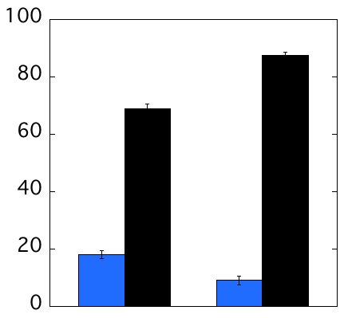
Fig. S3
Rim20 & Ime1 activation (% total cells)
6
8
6
8
pH
Rim20-GFP
foci
ime1-mCherry
expression

Slide 4
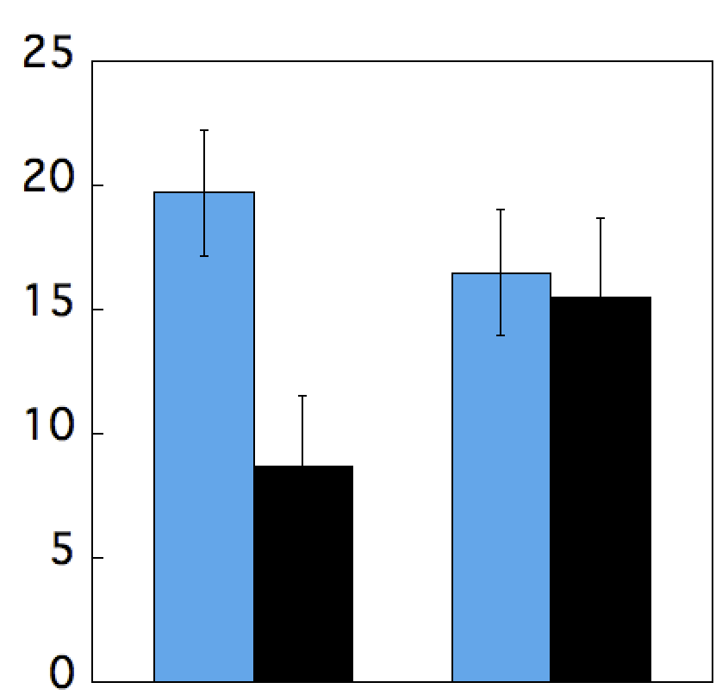
Fig S4
UAS_{Rlm1}-LacZ (% of total cells)
7
9
7
9
pH
RIM101
rim101Δ

Slide 5
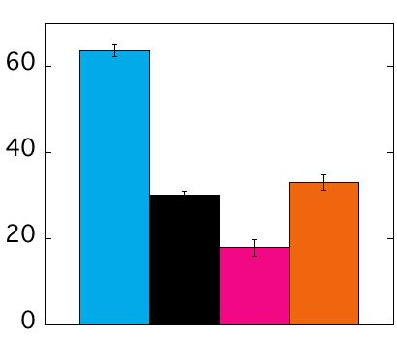
Fig S5
6 d
ime2Δ-GFP
WT
rim101
WT
rim101
Pure
Chimera

