Slide 1
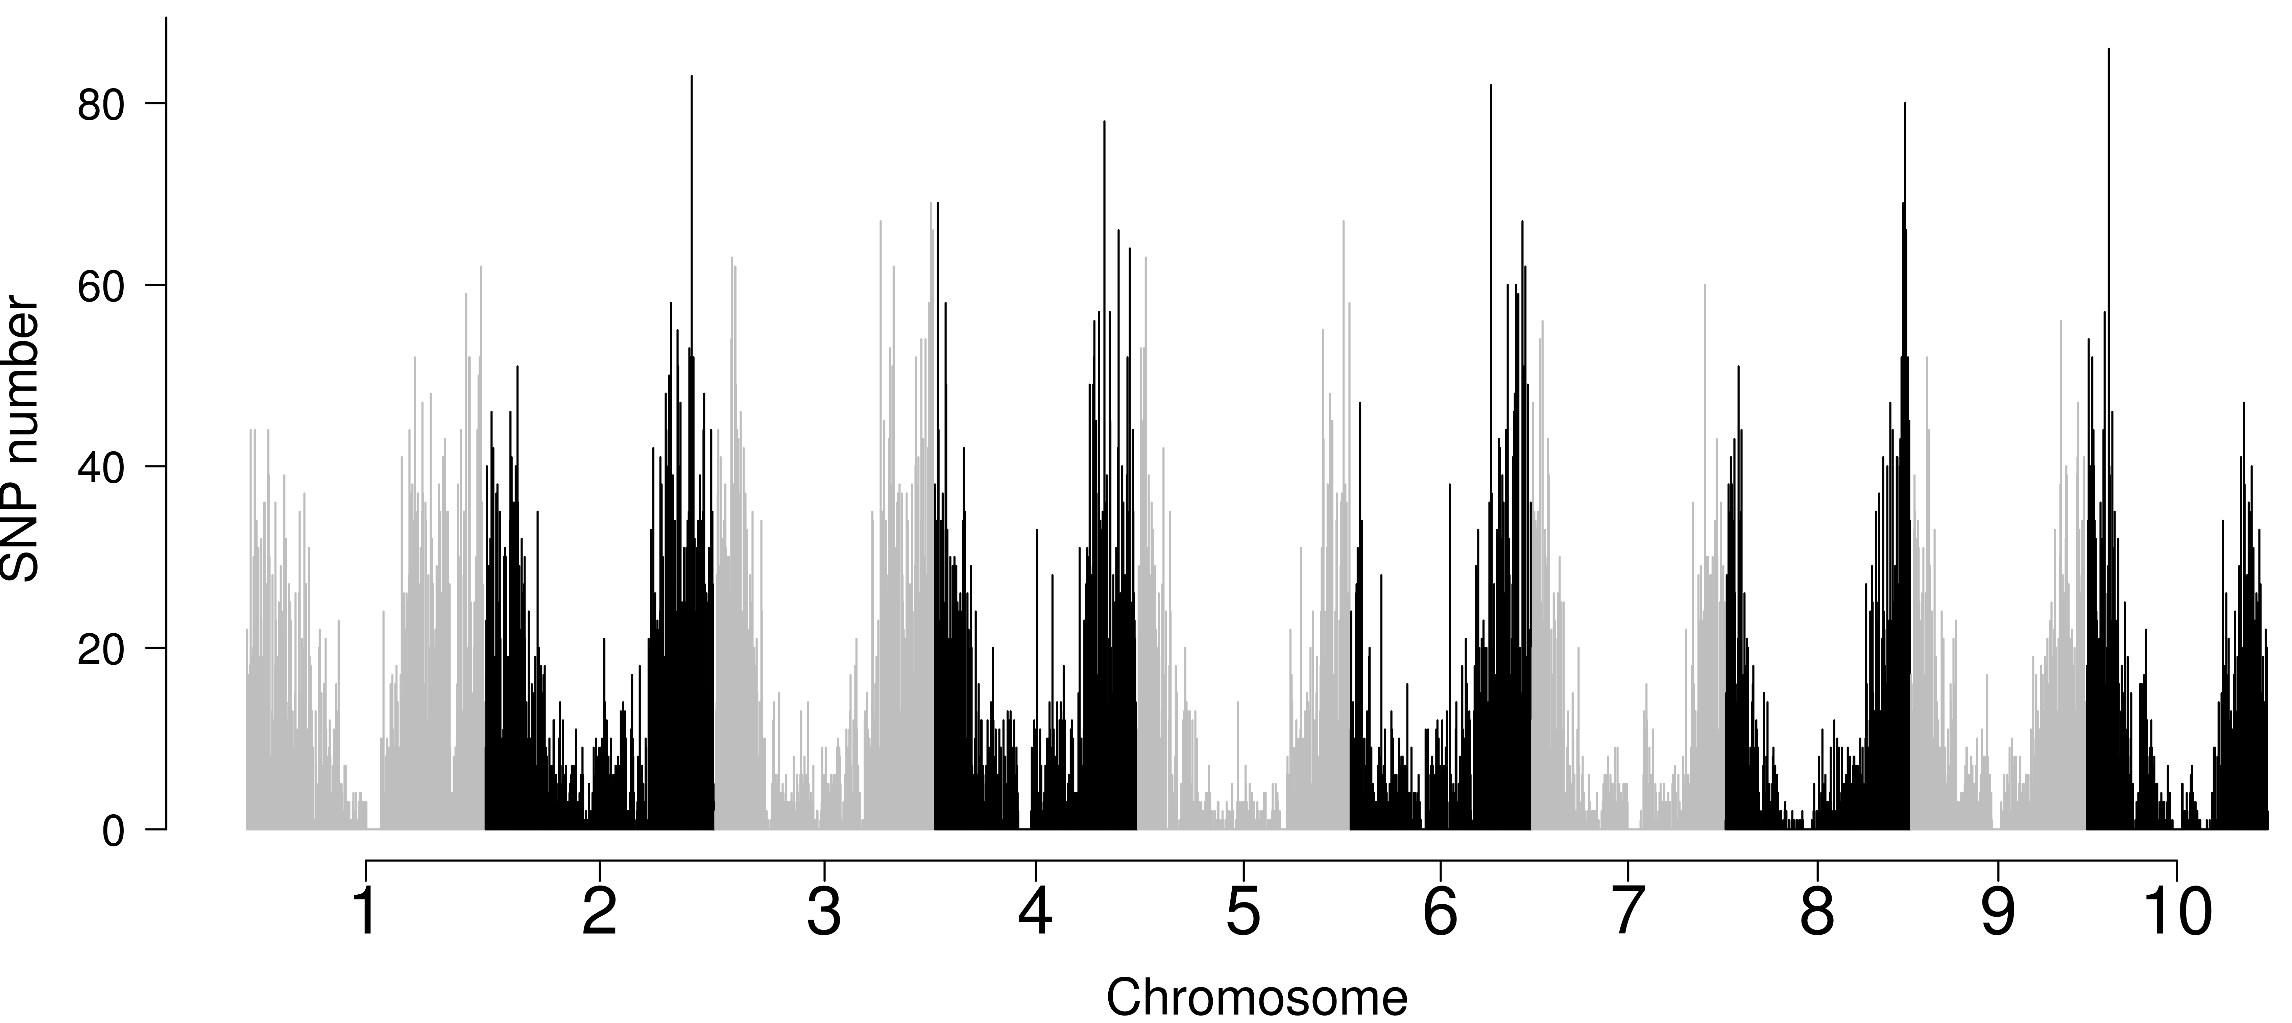
A
Figure S5
B
Kao_RILs
C
NSZ
HKZa_RILs
NSZ_RILs
HKZ
BTx623
Kao
HKZa_RILs
HKZb_RILs
NSZ_RILs
BTx623
Kao_RILs
HKZb_RILs
Kao
NSZ
HKZ
Figure S5. SNP density and genetic structure of the chilling NAM population.
(A) SNP density of the chilling NAM population calculated (in 200 kb windows) using VCFtools. Genetic relatedness of the NAM population characterized using (B) neighbor-joining analysis and (C) principal component analysis (PCA). The cluster with PC1>40 (indicated by a grey line) and longer branch on NJ dendrogram was assigned as the HKZb family (nRIL = 101)

