Slide 1
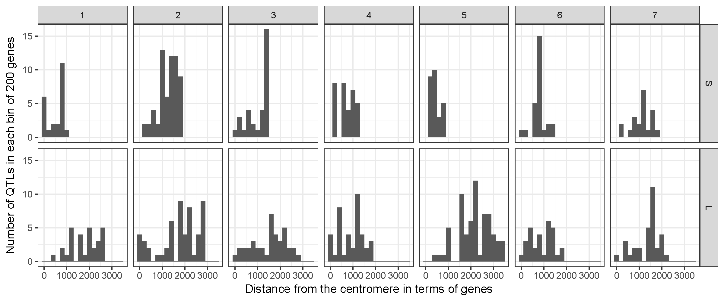
Supplemental Figure S1. QTL density along the Ae. tauschii chromosome arms. Numbers of QTL are expressed per a 200-gene bin (vertical axis) along the pseudomolecules of the short (upper row) and long (lower row) Ae. tauschii chromosome arms. The numbers of genes along the arm of the pseudomolecules are indicated on the horizontal axis. The arms are oriented with the centromeres to the left and telomeres to the right.

