Slide 1
WT
Oti-mom-5
Oti-lin-3
Oti-plx-1
Figure S1

Slide 2
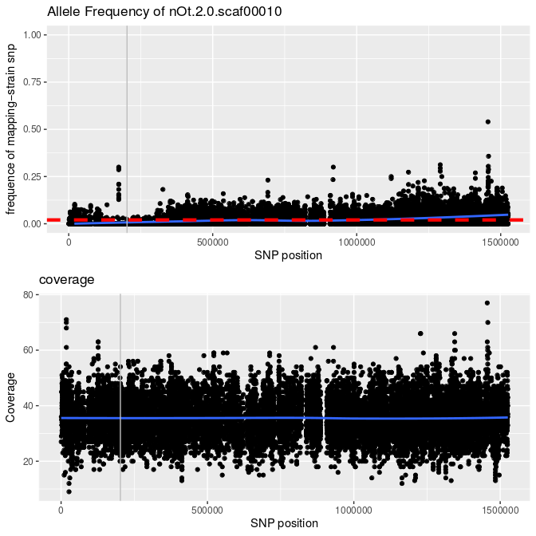
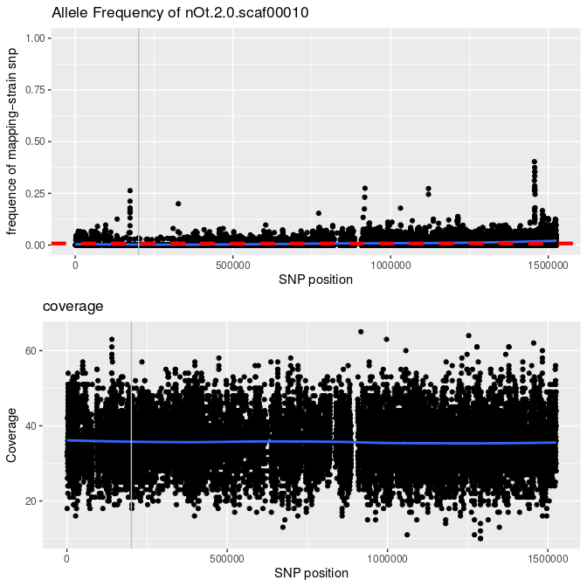
cov-4(sy465) – Scaffold 10
Frequency of mapping-strain
# of sequencing reads
cov-4(sy493) – Scaffold 10
Frequency of mapping-strain
# of sequencing reads
Figure S2

Slide 3
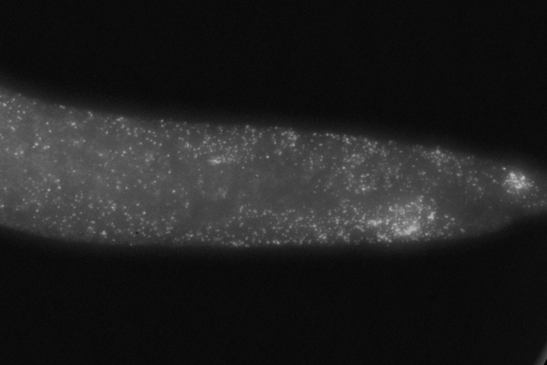
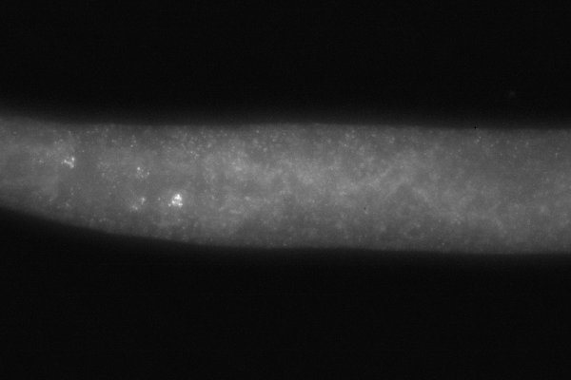
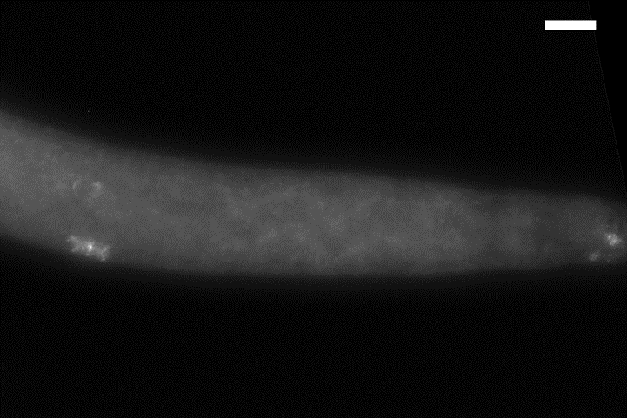
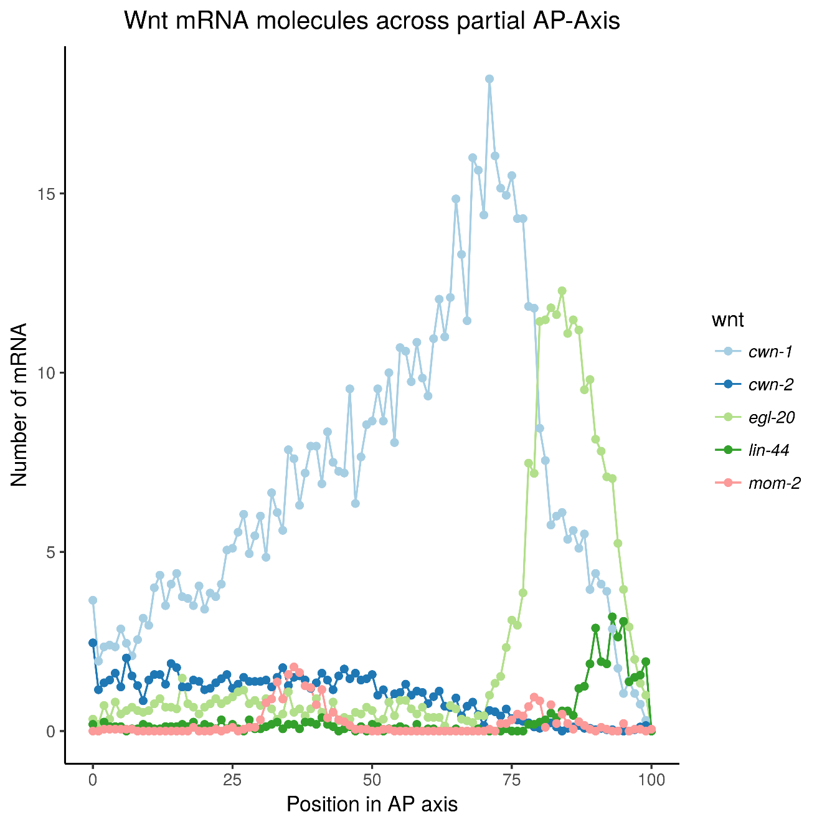
a)
Examples of smFISH images of Wnt mRNAs
Oti-cwn-1
Oti-cwn-2
Oti-lin-44
Terminal bulb
Sex myoblast
Anus
Expression across the posterior part
Expression in the pharynx and anterior part
Expression in the tail, P6.px, and SM
b)
Average expression of Wnt mRNAs
during the L3 stage
Average over at least 20 animals per smFISH experiment
#mRNA
Beginning of the gut identified by DAPI staining
0
.25
.5
.75
1
Last cell nucleus in the tail identified by DAPI staining
Fraction of the antero-posterior axis
Figure S3

Slide 4
a)
b)
Wnt Wnt receptors
Figure S4

Slide 5
a)
b)
Figure S5

Slide 6
a)
b)
SM
SM.x
P6.px
PD4666 ayIs6 [hlh-8::GFP fusion + dpy-20(+)]
Figure S6

Slide 7
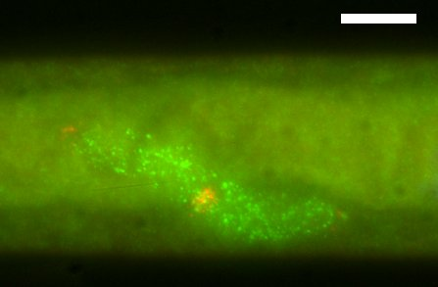
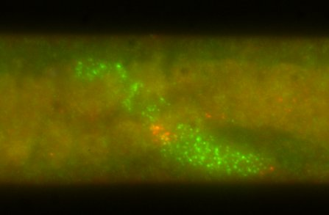
a)
bp before ATG
-500
-400
-300
-200
-100
C. elegans lin-3
O. tipulae lin-3
mf86 deletion
CACCTG
CACATG
[C|T]G[A|G]CC[C|G|T]TG[A|G]
‘canonical’
E-box site
alternative
putative E-box site
NHR binding motif
b)
Oti-lin-3
Oti-dsl
AC
AC
WT Oti-lin-3
Oti-lin-3(mf86)
Figure S7

