Slide 1
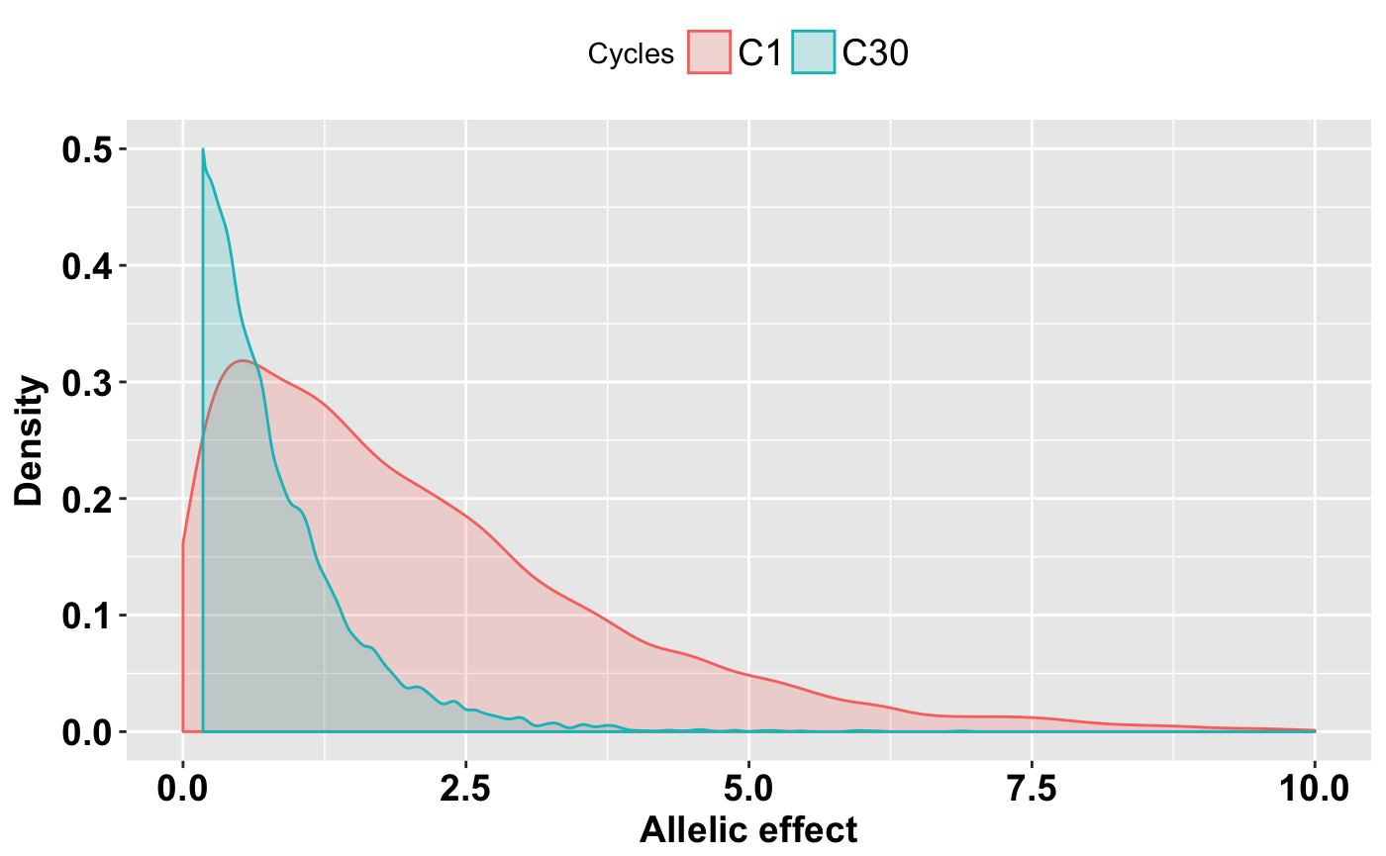
Figure S5: Shift in the trait genetic architecture due to selection. The distribution of allelic effects of genome-wide marker were compared for C1 and C30 population based on oligogenic architecture and population size of par₁₀₀_pop₁₀₀₀.

