Slide 1
Table S1. Strain and Plasmid Information
Strain | Genotype
JLY 1 | MATa his3∆1 leu2∆ lys2∆ ura3∆ sml1∆::LEU2
JLY 16 | MATa his3∆1 leu2∆ lys2∆ ura3∆ sml1∆::LEU2 rad53∆::NatMX
JLY 207 | MATalpha his3∆ leu2∆ ura3∆ lys2∆ ptc2∆::HanMX pph3∆::HIS5MX ptc3∆::NatMX
JLY 231 | MATalpha GAL1pr-RAD53::KanMX sml1∆::LEU2 lys2∆::NatMX arg4∆::HIS5MX
JLY 244 | MATa his3∆1 leu2∆0 ura3∆0 GAL1pr-RAD53::KanMX HphMX::TEF1-DUN1 sml1∆::LEU2 lys2∆::NatMX arg4∆::HIS5MX
JLY 256 | his3∆1 leu2∆0 ura3∆0 met15∆ GAL1pr-RAD53::KanMX HphMX::TEF1-DUN1 sml1∆::LEU2 ptc2∆::KanMX pph3∆::HIS5MX ptc3∆::NatMX
JLY 260 | MATa his3∆1 leu2∆0 ura3∆0 met15∆ GAL1pr-RAD53::KanMX sml1∆::LEU2 ptc2∆::KanMX pph3∆::HIS5MX ptc3∆::NatMX
JLY 286 | MATa his3∆1 leu2∆0 ura3∆0 lys2∆ sml1∆::LEU2 GAL1-RAD53::KanMX arg4∆::URA3 ptc2∆::KanMX pph3∆::HIS5MX ptc3∆::NatMX
JLY 287 | MATa his3∆1 leu2∆0 ura3∆0 lys2∆ sml1∆::LEU2 GAL1-RAD53::KanMX HphMX:TEF1-DUN1 arg4∆::URA3 ptc2∆::KanMX pph3∆::HIS5MX ptc3∆::NatMX
JLY 346 | MATa his3∆1 leu2∆ ura3∆ sml1∆::LEU2 Xrn1-GFP::HIS5MX
JLY 348 | MATa his3∆1 leu2∆ ura3∆ sml1∆::LEU2 rad53∆::NatMX Xrn1-GFP::HIS5MX
JLY 373 | MATa his3∆1 ura3∆0 leu2∆0 lys2∆ Xrn1-FLAG::HphMX sml1∆::LEU2
JLY 375 | MATa his3∆1 ura3∆0 leu2∆0 lys2∆ Xrn1-FLAG::HphMX sml1∆::LEU2 rad53∆::NatMX
JLY 508 | MATa his3∆1 leu2∆ lys2∆ ura3∆ sml1∆::LEU2 Xrn1∆1392-1528-3XFLAG::HphMX
JLY 509 | MATa his3∆1 leu2∆ lys2∆ ura3∆ sml1∆::LEU2 Xrn1∆1392-1528-3XFLAG::HphMX
JLY 523 | MATa his3∆1 leu2∆0 ura3∆0 lys2∆ arg4∆::URA3 sml1∆::LEU2
JLY 525 | MATa his3∆1 leu2∆0 ura3∆0 lys2∆ arg4∆::URA3 ptc2∆::KanMX pph3∆::HIS5MX ptc3∆::NatMX sml1∆::LEU2
JLY 537 | MATa his3∆1 leu2∆ ura3∆ sml1∆::LEU2 dun1∆::KanMX4 Xrn1-GFP::HIS5MX
JLY 592 | MATa his3∆1 leu2∆ lys2∆ ura3∆ sml1∆::LEU2 hhf2-hht2∆::NatMX
JLY 597 | MATa his3∆1 leu2∆ lys2∆ ura3∆ xrn1∆::KanMX sml1∆::LEU2
JLY 599 | MATa his3∆1 leu2∆ lys2∆ ura3∆ xrn1∆::KanMX sml1∆::LEU2 rad53∆::NatMX
JLY 607 | MATa his3∆1 leu2∆ lys2∆ ura3∆ hhf2-hht2∆::NatMX xrn1∆::KanMX4
JLY 609 | MATa his3∆1 leu2∆ lys2∆ ura3∆ sml1∆::LEU2 hhf2-hht2∆::NatMX xrn1∆::KanMX
JLY 626 | MATa his3∆1 leu2∆ ura3∆ sml1∆::LEU2 Xrn1-GFP::HIS5MX mec1∆::KanMX tel1∆::KanMX
JLY 715 | MATa his3∆1 leu2∆ met15∆ ura3∆ xrn1∆::KanMX ADE2::Xrn1-GFP::NatMX
JLY 718 | MATa his3∆1 leu2∆ met15∆ ura3∆ xrn1∆::KanMX ADE2::Xrn1-32A-GFP::NatMX
JLY 721 | MATa his3∆1 leu2∆ met15∆ ura3∆ xrn1∆::KanMX ADE2::Xrn1-32A∆C-GFP::NatMX
JLY 726 | MATa his3∆1 leu2∆ met15∆ ura3∆ ADE2::TEF1pr-Rnh1-6XHIS::NatMX
JLY 728 | MATa his3∆1 leu2∆ met15∆ ura3∆ xrn1∆::kanMX ADE2::TEF1pr-Rnh1-6XHIS::NatMX
JLY 730 | MATa his3∆1 leu2∆ lys2∆ ura3∆ sml1∆::LEU2 Xrn1∆C-3XFLAG::HphMX
yKU303 | his3∆1 leu2∆0 ura3∆0 hta1/htb1∆::KanMX
yKU309 | his3∆1 leu2∆0 ura3∆0 hta1/htb1∆::KanMX xrn1∆::HygMX
Plasmid | Information
pLK01C | pRS316 + Ndd1-FLAG Sld3-Myc
pJL67 | pRS402 + XRN1pr-Xrn1-GFP
pJL68 | pRS402 + XRN1pr-Xrn1S32-GFP-GFP
pJL69 | pRS402 + XRN1pr-Xrn1S32∆C-GFP-GFP
pJL71 | pRS402 + TEF1pr-Rnh1-6XHIS
All strains listed are in the S288c background.

Slide 2
0’
60’
120’
wild type
0’
60’
120’
rad53∆
Figure S1. Xrn1 foci formation in damage is independent of Rad53.
Wild type and rad53∆ cells were collected before or after damage (60’ or 120’ in 2 μg/mL 4-NQO) and Xrn1-GFP signal was visualized with Zeiss AxioImager M1.

Slide 3
Rpg1-GFP
Scd6-GFP
Nrp1-GFP
Xrn1-Flag
Xrn1-Flag
rad53∆
Xrn1-Flag
rad53∆
rad53∆
- + - + - +
- + - + - +
- + - + - +
I IP I IP I IP I IP I IP I IP
I IP I IP I IP I IP I IP I IP
I IP I IP I IP I IP I IP I IP
α-GFP
α-Flag
Edc3-GFP
Xrn1-Flag
Xrn1-Flag Npl3-GFP
rad53D
rad53∆
- + - + - +
- + - +
I IP I IP I IP I IP I IP I IP
I IP I IP I IP I IP
α-GFP
α-Flag
Xrn1-Flag YGR250C-GFP
Xrn1-Flag Ngr1-GFP
rad53∆
rad53∆
- + - +
- + - +
I IP I IP I IP I IP
I IP I IP I IP I IP
α-GFP
α-Flag
α-Rad53
Pat1-GFP
Pbp1-GFP
Xrn1-Flag
Xrn1-Flag
rad53∆
rad53∆
- + - + - +
- + - + - +
I IP I IP I IP I IP I IP I IP
I IP I IP I IP I IP I IP I IP
α-GFP
α-Flag
α-Rad53
Figure S2. Co-IP of Xrn1-FLAG and P-body components.
Co-IP of Xrn1-FLAG in wild type or rad53∆ with GFP against the protein indicated. Asynchronous cells were untreated (-) or treated (+) with 0.05% MMS for 3 hours.

Slide 4
Arx1-GFP
Hsp26-GFP
Xrn1-Flag
Xrn1-Flag
rad53∆
rad53∆
- + - + - +
- + - + - +
I IP I IP I IP I IP I IP I IP
I IP I IP I IP I IP I IP I IP
α-GFP
α-Flag
α-Rad53
Eap1-GFP
Mss116-GFP
Xrn1-Flag
Xrn1-Flag
rad53∆
rad53∆
- + - + - +
- + - + - +
I IP I IP I IP I IP I IP I IP
I IP I IP I IP I IP I IP I IP
α-GFP
α-Flag
α-Rad53
Figure S3. Validation of Xrn1 interaction with proteins identified from SILAC IP mass spectrometry for interacting proteins.
Co-IP of Xrn1-FLAG with GFP tagged protein as indicated. Asynchronous cells were untreated (-) or treated (+) with 0.05% MMS for 3 hours.

Slide 5
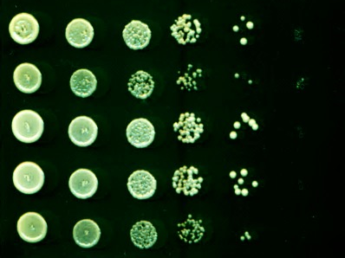
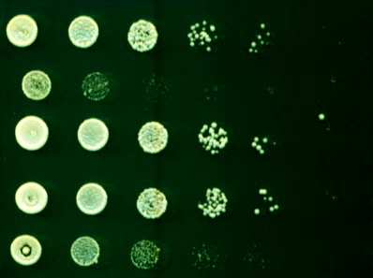
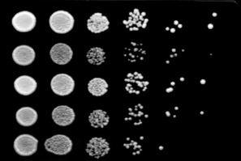
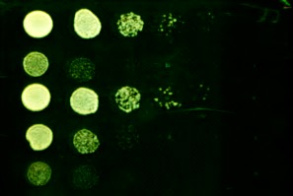
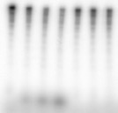
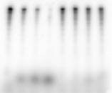
A.
Xrn1
Xrn1-∆1392
Xrn1-∆C
Xrn1-32A
32A
Xrn1-32A∆C
32A
B
10 μg/ml Phleo
WT
xrn1∆
Xrn1
Xrn1-∆1392
Xrn1-∆C
WT
xrn1∆
Xrn1
Xrn1-32A
Xrn1-32A∆C
C
Xrn1-
32A∆C
D.
Xrn1 Xrn1-32A
Mock IP 60’
Mock IP 60’
Xrn1 Xrn1-∆C
0
15’ 30’60’15’30’60’15’30’60’
0
15’ 30’60’15’30’60’
RNA
NMP
GFP IP
FLAG IP
Figure S4. Mutations in the C terminus of Xrn1 abolish its nuclease activity.
A) Red popsicles indicate phosphosites identified from targeted phosphopeptide mass spec of Xrn1-FLAG (clustered) and from original screen (single red popsicle). 32A indicates region in which 32S/T residues spanning the 6 identified sites were mutated to A. Dark blue box indicates region that is different between Xrn1-∆1392-1528 and Xrn1-32A∆C. B) Tenfold serial dilutions of the indicated strains grown on YPD or YPD + 10 μg/mL Phleo. Plates were grown at 30°C for 2-3 days before scanning.
C) In vitro nuclease assay with Rad53 (FLAG) and Xrn1 alleles (GFP or FLAG as indicated) as substrates showing ³²P signal. D) Quantification of product (NMP) formation in C.

