Slide 1
Figure S1: Gendreau et al
Dataset 1
(Koike)
Dataset 2
(Vollmers)
Dataset 3
(Zhang)
0
0
0
APA index
18
6
18
6
18
6
12
12
12
Notes:
Supplemental Figure 1. Circular histogram plots of circadian APA index in individual datasets. Each wedge represents a 2-h bin.

Slide 2
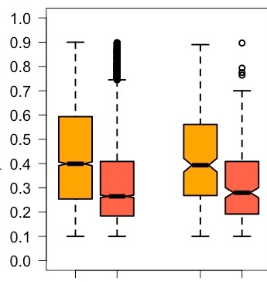
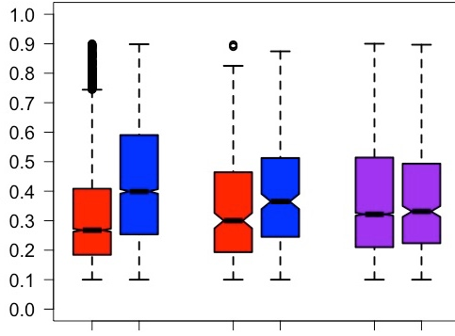
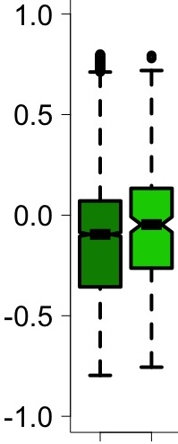
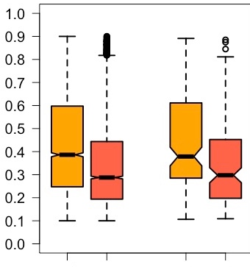
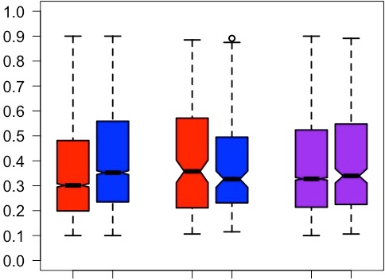
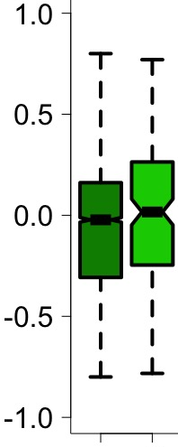
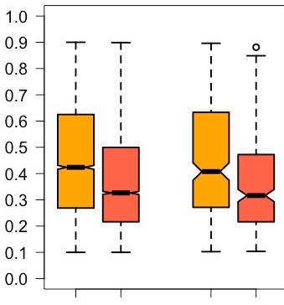
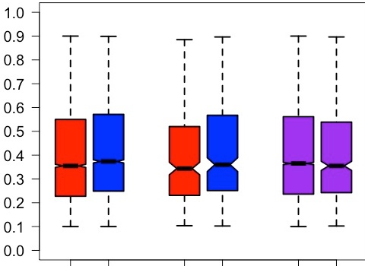
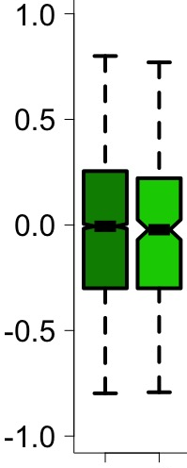
Figure S2: Gendreau et al
A
B
*
*
C
***
***
***
***
***
ψ value
ψ value
APA index
Dataset 1 (Koike)
***
***
***
*
ψ value
ψ value
Dataset 2 (Vollmers)
APA index
***
***
***
Dataset 3 (Zhang)
APA index
ψ value
ψ value
Others
Others
Distal
Distal
All
AAUAAA
AAUAAA
Proximal
Proximal
All (both)
All
Rhythmic
All
Rhythmic
Rhythmic (both)
Rhythmic
Notes:
Supplemental Figure 2. Comparison of PAS sequence, poly(A) sites, and APA index between all and rhythmic APA transcripts in each dataset. (A) Distributions of y values in transcripts that have canonical PAS (AAUAAA) or other PAS variants. Dataset 1 (Koike): All: AAUAAA; n=4841, others; n=4863, and rhythmic: AAUAAA; n=267, others; n=271. Dataset 2 (Vollmers): All (AAUAAA; n=4088, others; n=4426), and rhythmic (AAUAAA; n=161, others; n=153). Dataset 3 (Zhang): All (AAUAAA; n=5708, others; n=6571), and rhythmic (AAUAAA; n=296, others; n=298). (B) Distributions of y values between transcripts that use distal or proximal PASs. Dataset 1 (Koike): All (proximal=4852 and distal=4852), Rhythmic (proximal=269 and distal=269). Dataset 2 (Vollmers): All (proximal=4257 and distal=4257), Rhythmic (proximal=157 and distal=157). Dataset 3 (Zhang): All (proximal=6137 and distal=6137), Rhythmic (proximal=237 and distal=237). (C) Distribution of the APA index between all and rhythmic APA transcripts. Dataset 1 (Koike): All (n=4852), Rhythmic (n=269). Dataset 2 (Vollmers): All (n=4257), Rhythmic (n=157). Dataset 3 (Zhang): All (n=6137), Rhythmic (n=237). All the box-whisker plots represent quartiles (box) and quartile ± 1.5 interquartile range (whiskers). *; p<0.05. ***; p<0.005 (Mann-Whitney-Wilcoxon Test).

Slide 3
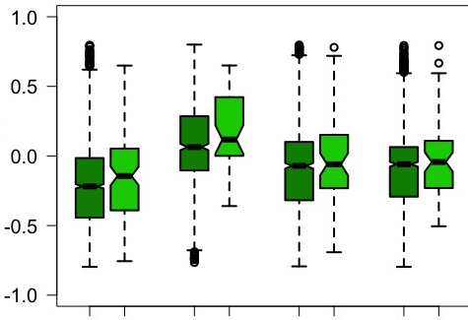
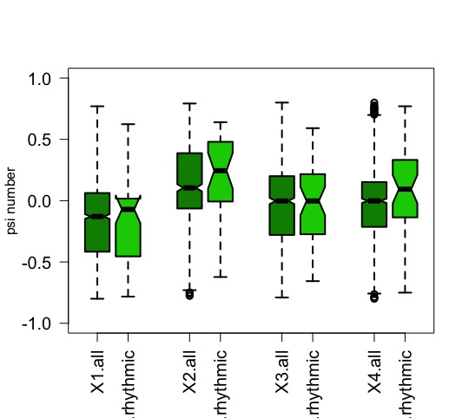
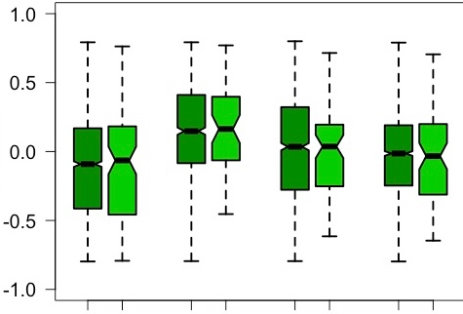
Figure S3: Gendreau et al.,
A
ALL
Rhythmic
B
*
23%
(1116)
39%
(1895)
22%
(59)
41%
(111)
Dataset 1 (Koike)
21%
(57)
APA index
23%
(1105)
15%
(736)
16%
(42)
***
*
26%
(1093)
38%
(1642)
26%
(41)
27%
(43)
Dataset 2 (Vollmers)
APA index
22%
(924)
14%
(598)
29%
(45)
18%
(28)
28%
(1729)
36%
(2205)
24%
(72)
34%
(102)
Dataset 3 (Zhang)
24%
(71)
APA index
21%
(1295)
15%
(908)
18%
(52)
others- AAUAAA
AAUAAA - AAUAAA
All
All
All
All
others - others
Rhythmic
Rhythmic
Rhythmic
Rhythmic
AAUAAA - others
P: Others
D: AAUAAA
P: AAUAAA
D: Others
P: AAUAAA
D: AAUAAA
P: Others
D: Others
Notes:
Supplemental Figure 3. Categorization of APA transcripts by the PAS combination in mouse liver in individual datasets. A) Percentages of each PAS combination groups. Dataset 1 (Koike) All: N=4852, Rhythmic: N= 269. Dataset 2 (Vollmers) All: N=4257, Rhythmic: N= 157. Dataset 3 (Zhang) All: N=6137, Rhythmic: N= 97. Numbers in parentheses indicate the number of transcripts that fall under each combination group. B) Distribution of the APA index in each PAS group. All the box-whisker plots represent quartiles (box) and quartile ± 1.5 interquartile range (whiskers). *; p<0.05. (Mann-Whitney-Wilcoxon Test).

